Slide 1
Spin-Mode-Switching at the nu=3 edge
Ganpathy Murthy
Mizpe Ramon, May 31, 2018
University of Kentucky, and the Technion

Slide 2
Acknowledgements
NSF, US-Israel BSF, Aspen Center for Physics
Lady Davis Fellowship from the Technion
Udit Khanna, GM, Sumathi Rao, and Yuval Gefen, PRL 119, 186804 (2017).

Slide 3
A somewhat lesser known collaborator

Slide 4
Outline
The QHE
Why study Quantum Hall Edges?
Edge Reconstruction: Review
Mode-Switching at nu=3
Experimental Signatures
Conclusions

Slide 5
The Quantum Hall Effects

Slide 6
Quantum Hall Edges

Slide 7
Properties of Quantum Hall Edges
Each edge mode is chiral. In the noninteracting integer QHE each mode carries a charge of e.
The sum of the charge times chirality is the Hall conductance, which is a quantized, topologically protected, property of the bulk.
In Abelian quantum Hall states, the sum of the chiralities of the modes is the thermal Hall conductance, another quantized and topologically protected property.
Subject to these constraints, anything can happen depending on the details of interactions, disorder, and the confining edge potential.

Slide 8
Some recent puzzling/exciting phenomena at the edge
A nu=2/3 edge mode in a bulk nu=1 sample (Venkatachalam et al 2012).
“Pairing” of electrons near nu=3 (Choi et al 2014).
1/3 edge modes seen in a nu=2/3 bulk sample (Sabo et al, 2017).
Observation of fractional thermal Hall conductance at nu=5/2 (Banerjee et al, arXiv:1710).

Slide 9
Edge Reconstruction Review
Wang, Meir, Gefen, 2017

Slide 10
Chamon and Wen, 1994

Slide 11
An even more complicated case

Slide 12
The nu=3 bulk

Slide 13
An Argument for a reconstruction

Slide 14
Two New Edge Phases!

Slide 15
Hartree Fock Results

Slide 16
Some Obvious Questions
Level crossings or avoided crossings?
What is the order of the transition?
What is the order parameter, if any?
What is the “driving force” behind the transition?

Slide 17
All crossings are avoided in unrestricted HF

Slide 18
The transitions are first-order in the order parameter

Slide 19
The electronic density doesn’t change through the transition

Slide 20
Experimental Signatures in setups with QPCs Spin Transport

Slide 21
Charge Transport: Strong Plateau

Slide 22
Charge Transport: Weak Plateau

Slide 23
Conclusions and Open Questions
We have discovered a new kind of edge reconstruction driven purely by exchange.
Spin-Mode-Switching has very striking signatures in spin transport, and more subtle ones in charge transport.
Should occur for other integer and even fractional states which have partial polarization.
Is there a neutral spin mode? If so, there would be an upstream chiral and decoherence.

Slide 24
Thanks and Happy Birthday, Yigal!

Slide 25
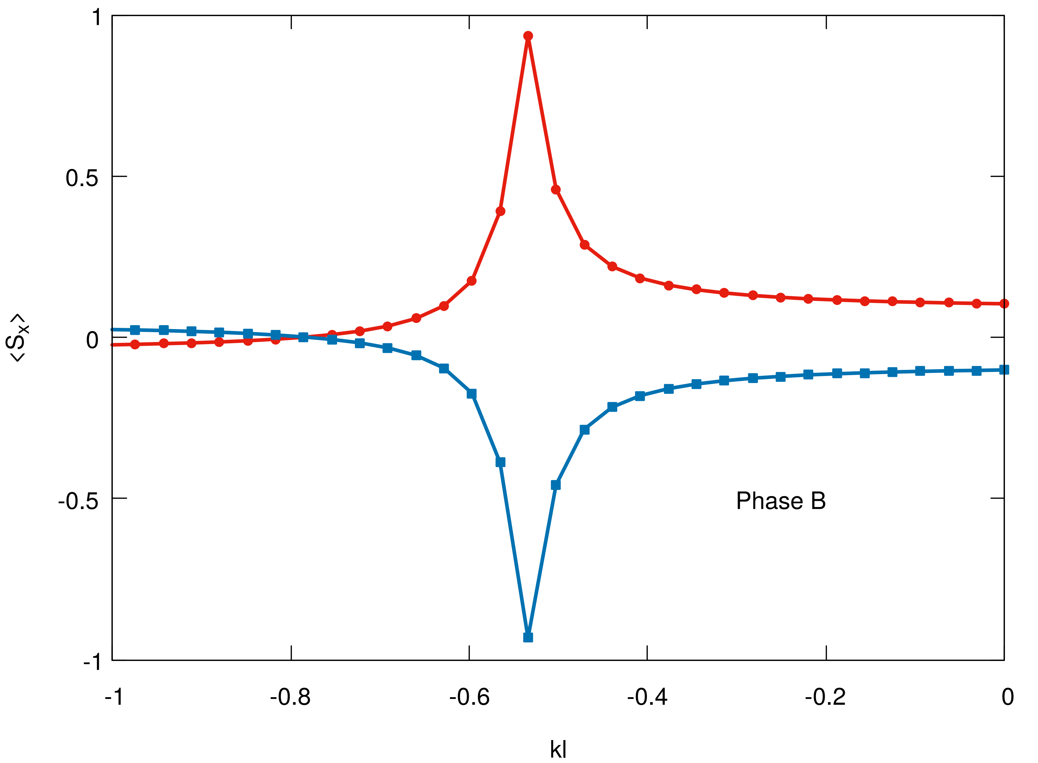
The spin rotations of the two occupied states in Phase B

