Slide 1
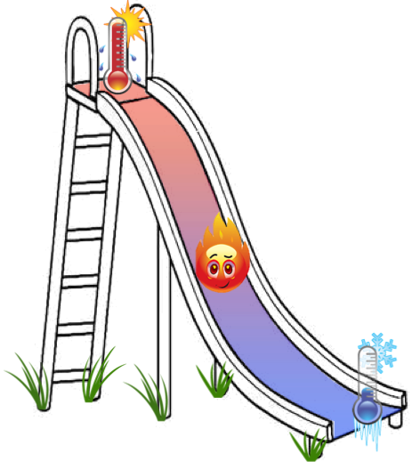
quantization of 1D heat flow
- fractional quantum Hall effect -
Mitali Banerjee
Amir Rosenblatt
Vladimir Umansky
Dima Feldman, Brown Univ.
Yuval Oreg
Ady Stern

Slide 2
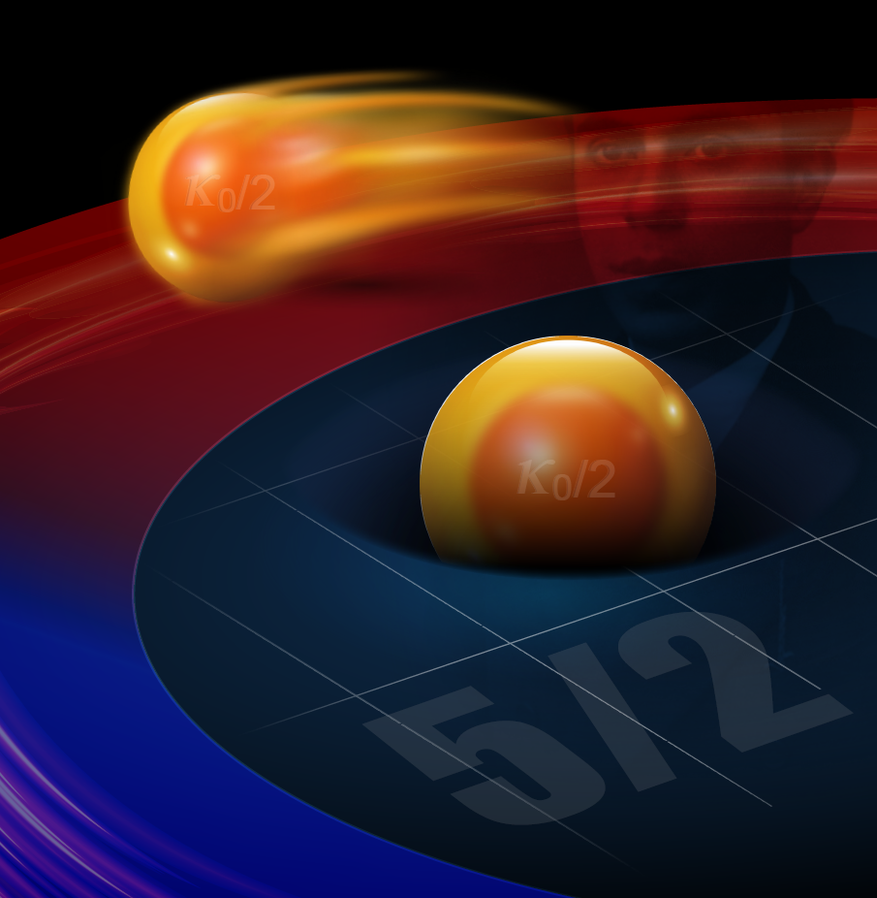
1D quantization of heat flow
- fractional quantum Hall effect -
Mitali Banerjee
Amir Rosenblatt
Vladimir Umansky
Dima Feldman Brown
Yuval Oreg
Ady Stern

Slide 3
fractional quantum Hall states are fascinating…
states were predicted to host:
fractionally charged quasiparticles….PROVED
unusual fractional statistics………NEVER PROVED
must interference

Slide 4
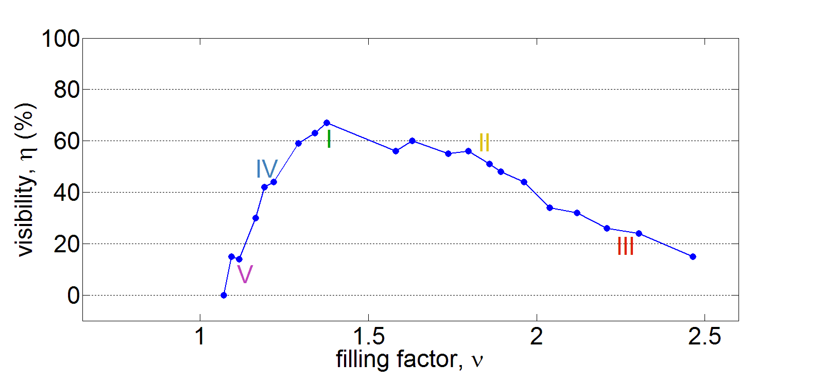
we looked for fractional statistics via interference………for years
interference of fractions was reported …
Willet (v =5/2), Goldman (v =1/3), Kang (v =5/2)
we observed though….
Mach - Zehnder interferometer
fractional

Slide 5
yet….
thermal transport may distinguish
non abelian vs abelian states

Slide 6
Pendry’s theory for 1D heat transport
1D channel
non-interacting particles
J B Pendry
Quantum limits to the flow of information and entropy
J. Phys. A: Math. Gen. 16 (1983) 2161-2171
thermal energy = temperature x entropy
entropy = log 2 x information
universal upper limit of information transfer
thermal conductance KT < κ₀T

Slide 7
1D ballistic transport
quantum of thermal conductance

Slide 8
Weideman – Franz ballistic 1D channel
for non-interacting electrons

Slide 9
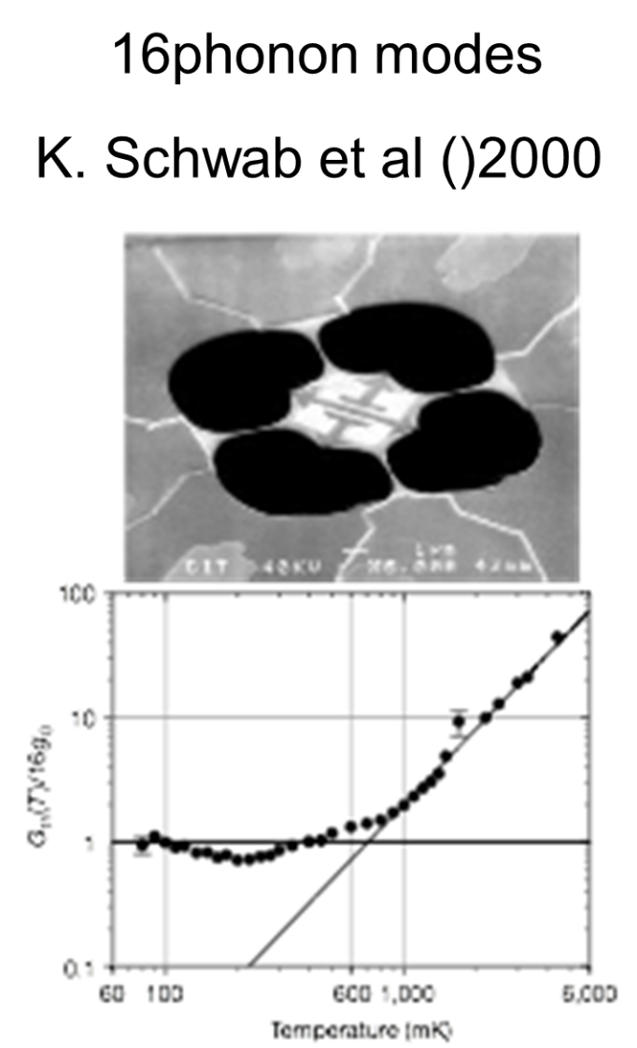
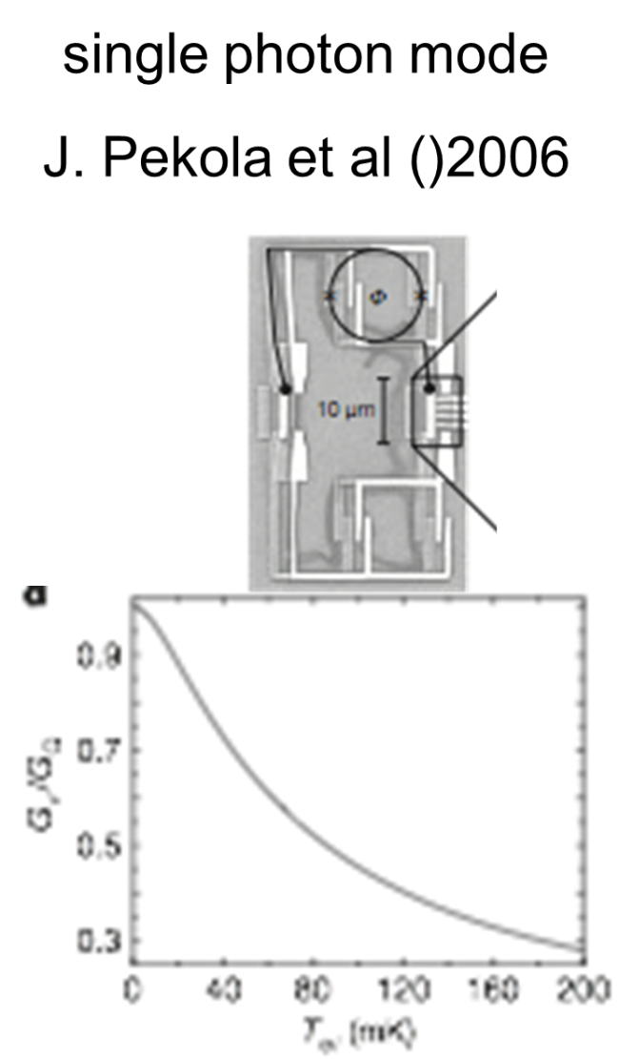
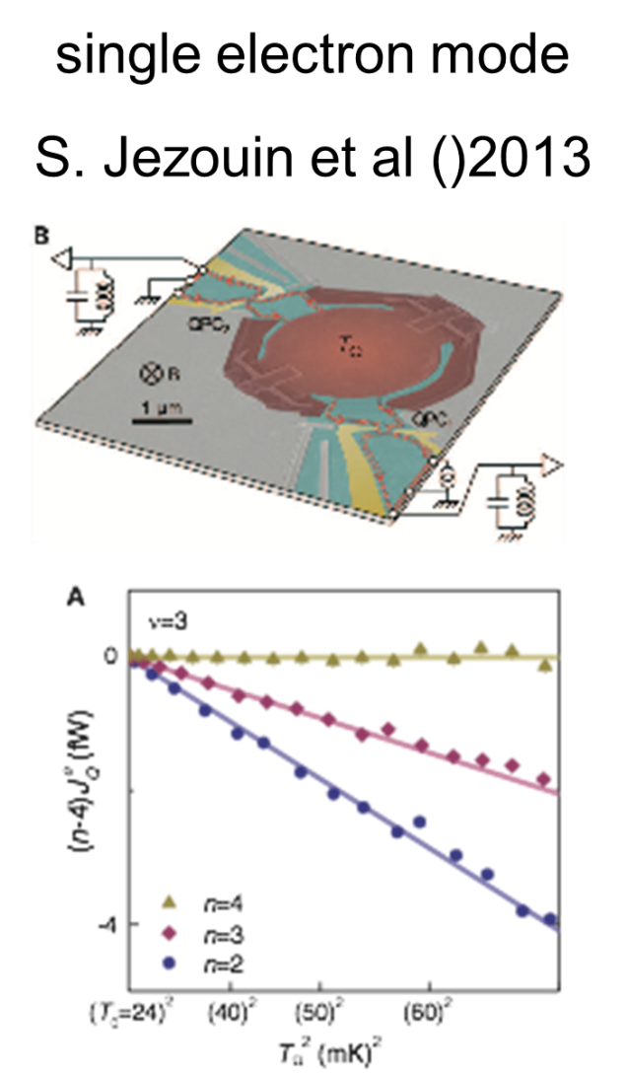
past experiments…. in accord with theory
16 phonon modes single photon mode single electron mode
Schwab et al, 2000 Meschke et al, 2006 Jezouin et al, 2013
Weideman – Franz

Slide 10
Pendry’s theory extended for interacting particles
our 1D interacting system……FQHE
Kane, C. L. & Fisher, M. P. A.
Quantized thermal transport in the fractional quantum Hall effect
Phys. Rev. B 55, 15832–15837 (1997)
interactions do not affect
the thermal conductance
Κ_{max} =κ₀
_{Weideman - Franz breaks down}

Slide 11
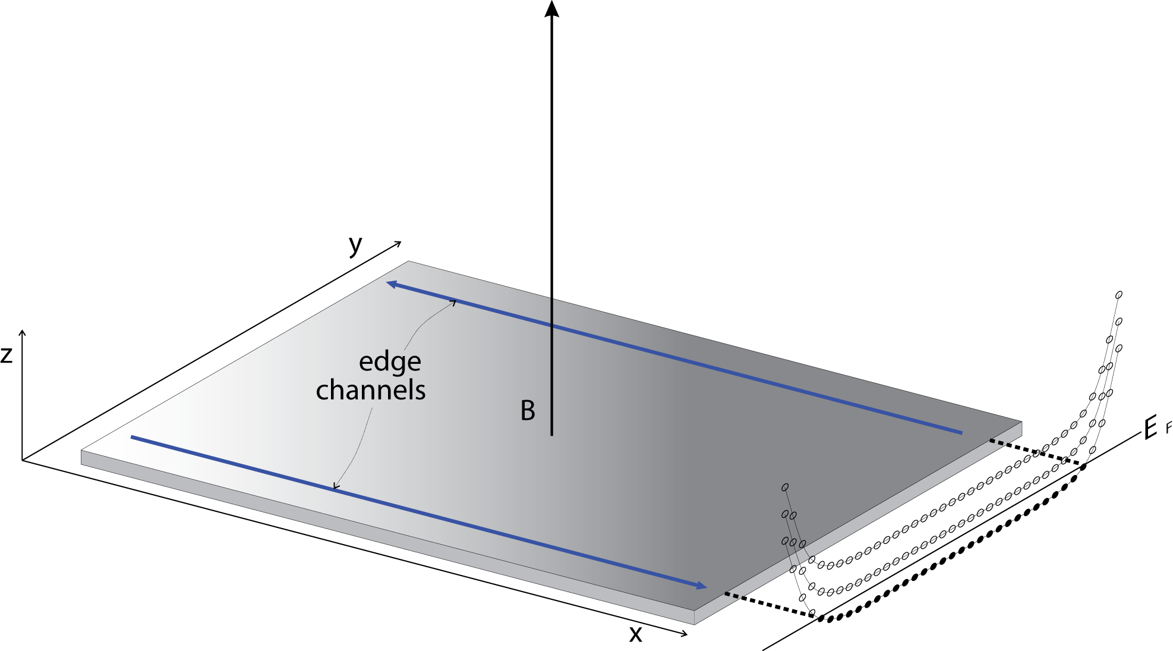
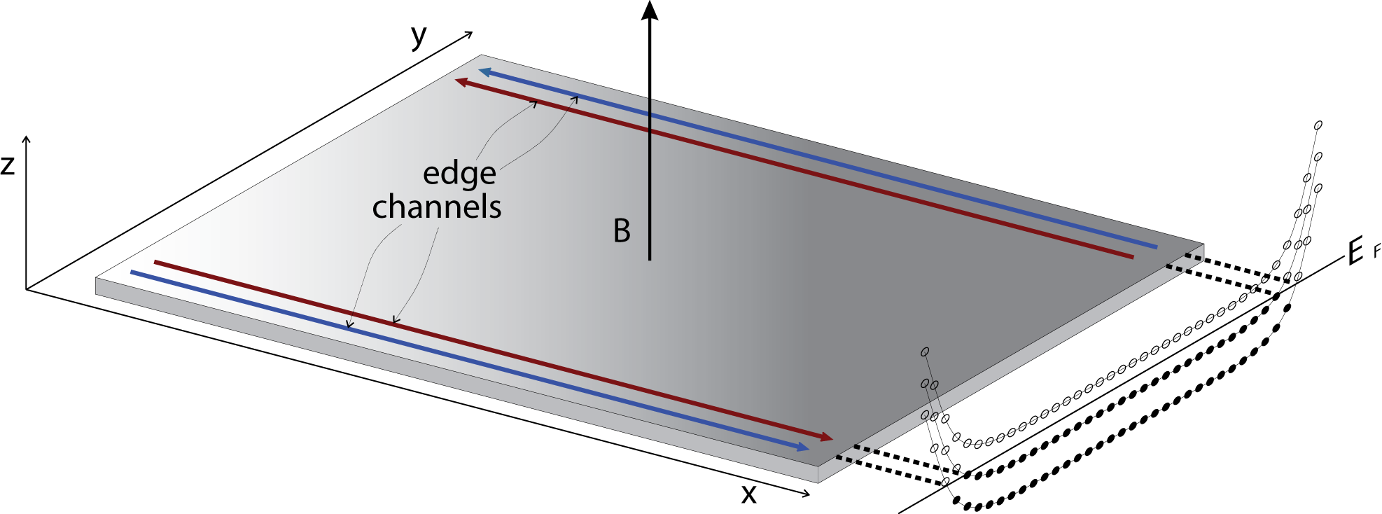

chiral edge modes
each edge mode carries

Slide 12
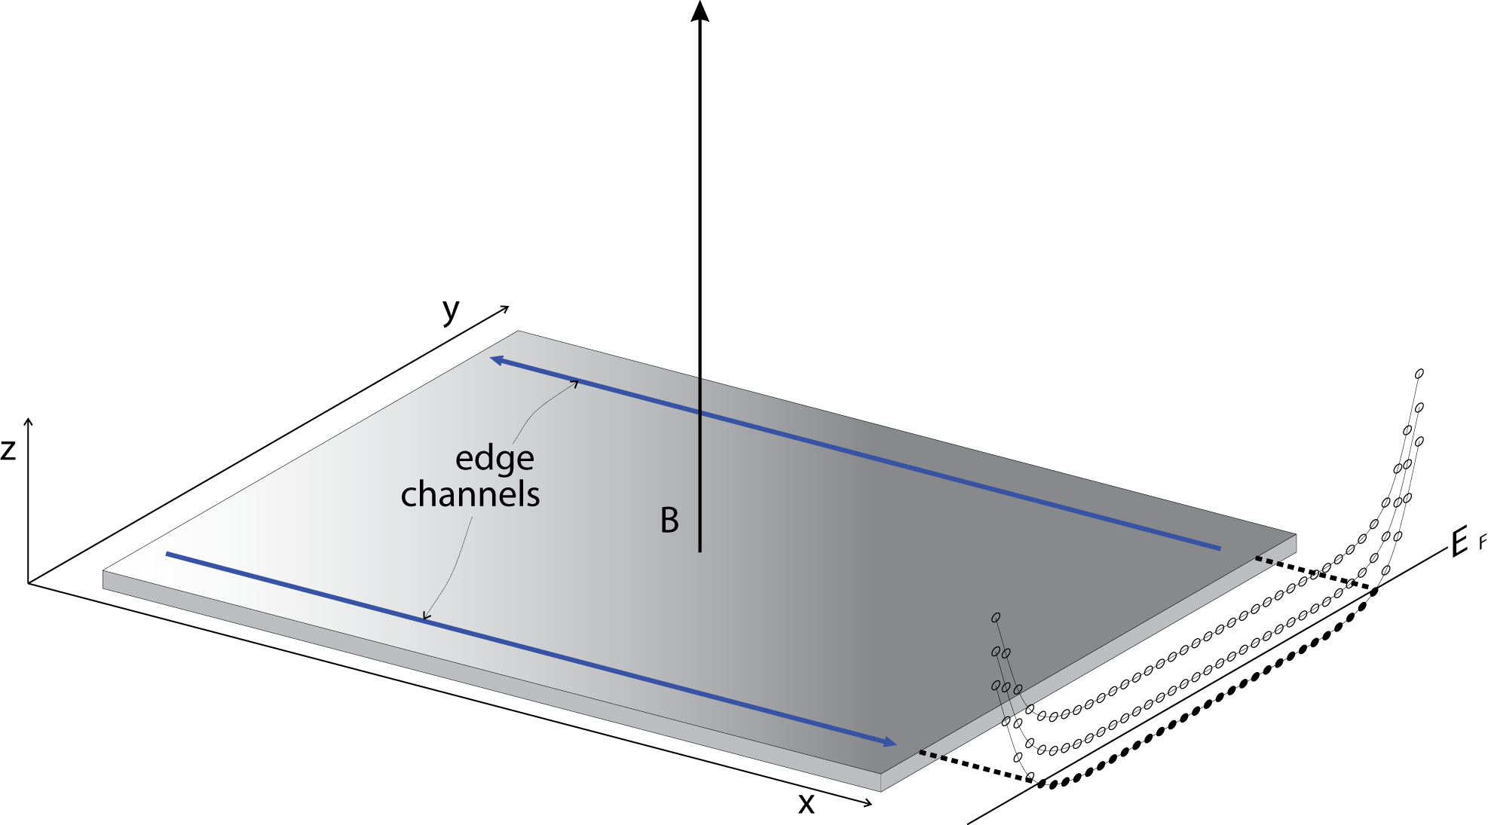
1D modes in QHE
bulk of QHE …………insulating → localized quasiparticles
edge of IQHE ………integer 1D chiral edge modes G_{H} =v e ²/h v =1, 2, 3,…
edge of FQHE ……..fractional 1D chiral edge modes
abelian states ……………..G_{H} =v e ²/h v =1/3, 2/5,.., 2/3, 3/5, 4/7,…
non-abelian states (?) ……….G_{H} =v e ²/h v =5/2, 12/5,…

Slide 13
types of modes….
downstream charge ……………………………..particle states
downstream charge + upstream neutral…hole states, non-abelian states

Slide 14
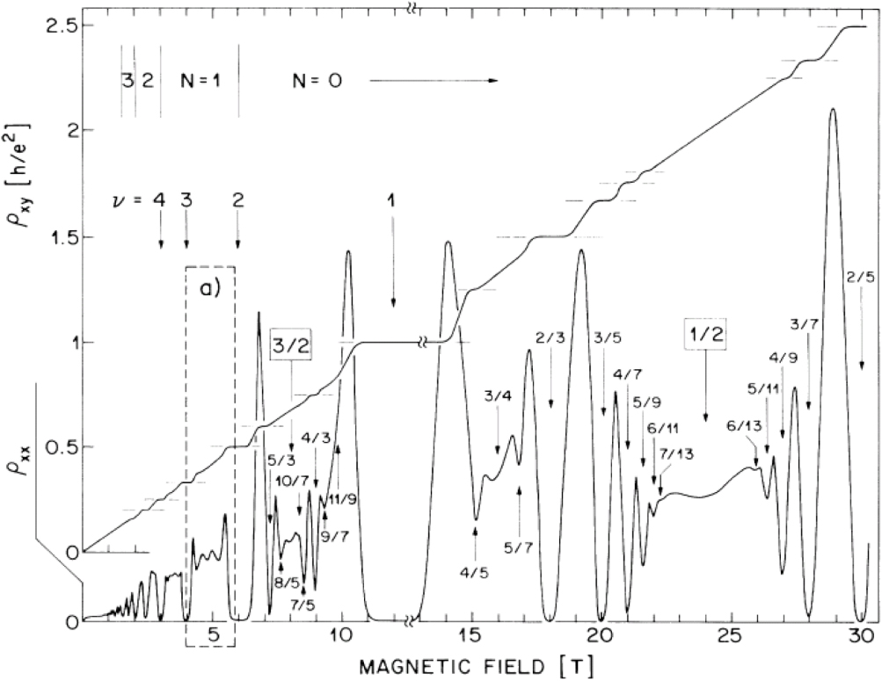
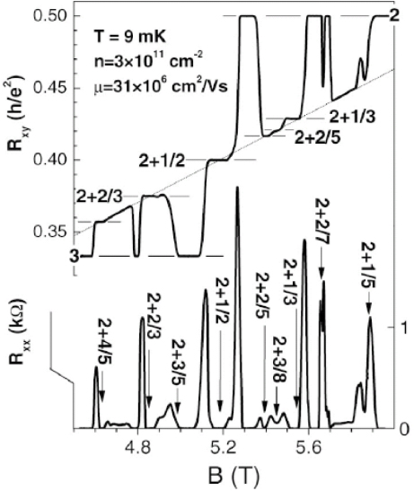
non-abelian ?
hole-like
counter-propagating
particle-like

Slide 15
why thermal conductance ?
topological number - determined by bulk wave-function
reveals the NET chirality of modes….down - up
independent of unexpected edge – reconstruction
provides proof of non-abelian states (w/ Majorana)

Slide 16
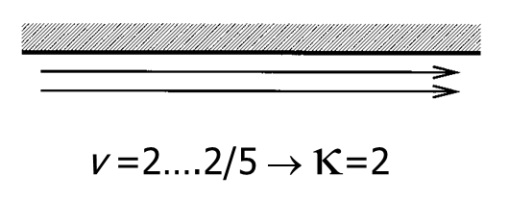
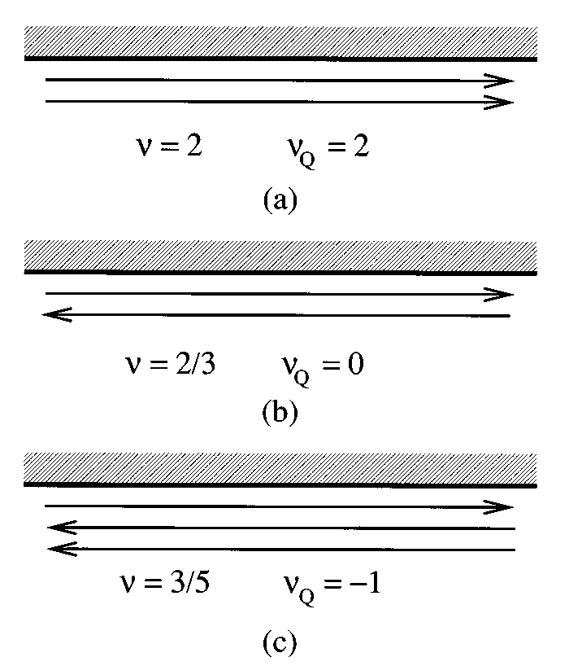
Κ in lowest LL…Kane & Fisher 1997
v =1/3 → κ₀
1 composite fermion mode
v =2/5 → 2κ₀
2 composite fermion modes
v =2/3 → 0
1 charge down - 1 neutral up
v =3/5 → -κ₀
1 charge down - 2 neutral up

Slide 17
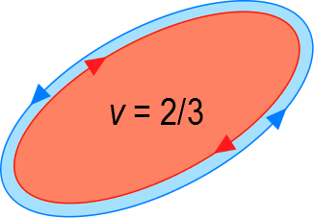
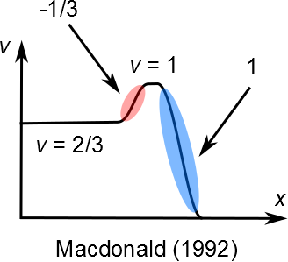
hole - like ν = 2/3
non-equilibrated
ν = 2/3 = 1 – 1/3_{upstream}
Κ = 0
MacDonald, A. H.
Edge states in the fractional quantum Hall effect regime
Phys. Rev. Lett. 64, 220–223 (1990)

Slide 18
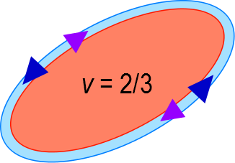
hole - like ν = 2/3
v = 2/3 = 2/3_{down} – neutral_{up}
Κ = 0
Kane, C. L., Fisher, M. P. A. & Polchinski, J.
Randomness at the edge:
theory of quantum Hall transport at filling 2/3
Phys. Rev. Lett. 72, 4129–4132 (1994)
neutral modes....carrying energy w/o net charge

Slide 19
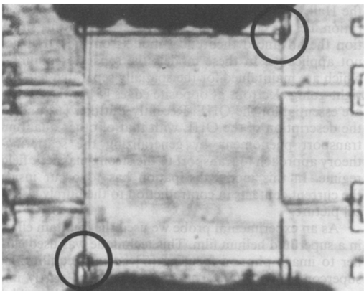
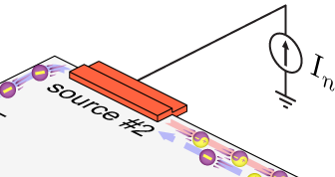

excitation of neutral modes at ohmic contact
qp
‘back - side’ of ohmic contact
He4 bubbles
upstream
hot spot
E_{F}+eV_{n}
E_{F}
U. Klass, W. Dietsche, K. von Klitzing & K. Ploog
Image of the dissipation in gated
quantum Hall effect samples
Surface Science 263, 97-99 (1992)
dissipated power = 0.5 I_{n}V_{n}

Slide 20
neutral modes
    are invisible in common measurements
    bosonic thermal conductance κ₀
    present in particular FQHE wavefunctions
    possible source of quasiparticle dephasing

Slide 21
the experiments

Slide 22


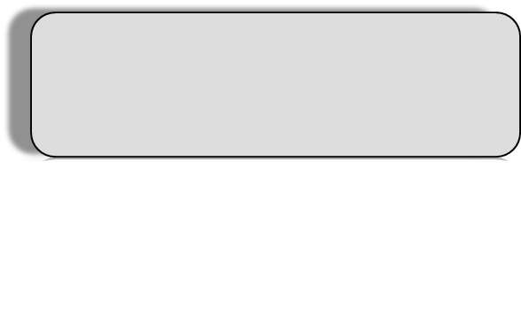
working principle
electrons
phonons
flow of dissipated power…..
hot reservoir
cold reservoir
J_{e}
Tm
T0
1D electronic channel
dissipated power
β = (3-7) nW K⁻⁵
Wellstood, F. C., Urbina, C. & Clarke, J.
Hot-electron effects in metals.
Phys. Rev. B 49, 5942–5955 (1994)
input power

Slide 23
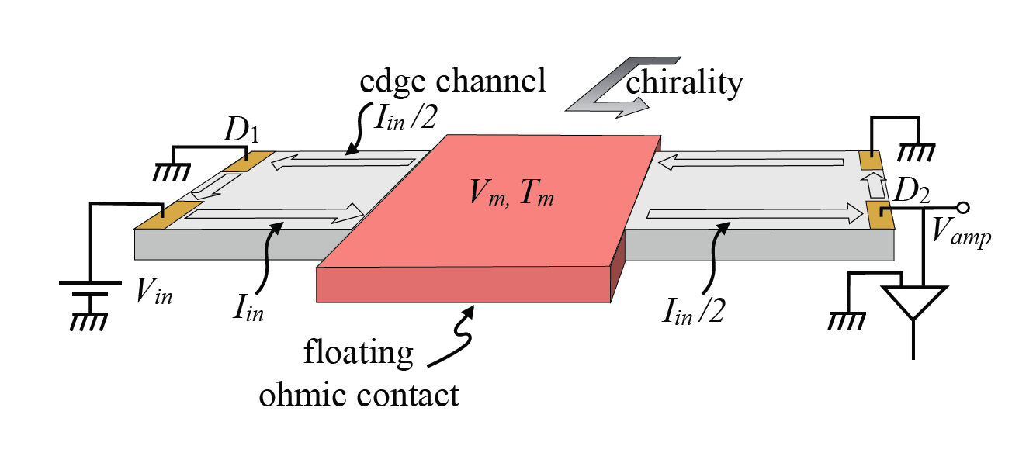
replacing
heating reservoir w/ current …
V_{in} , I_{in}
G_{Hall}
ΔP =P_{in} - P_{out}
I_{out} = I_{in}
V_{m} =V_{in} /2
P_{out}=P_{in} /2
ΔP= P_{in}-P_{out}=P_{in} / 2
Jezouin et al., Science 2013

Slide 24
N arms device
3
Iin
dissipated power
Vin
1
Tm
2
4
N =4

Slide 25
we measure only…
electron temperature in grounded contacts…..T₀
electron temperature in heated reservoir…….T_{m}

Slide 26
measuring T₀ ……shot noise
I_{S}
t
e*=2e/3
± 0.5mK

Slide 27
measuring T_{m} ……Johnson-Nyquist noise
Tm
current fluctuations
A
dissipated power, ΔP
4k_{B}T_{m}G
modes leave contact with noise 4k_{B}T_{m}G
even if modes cool down with distance…
low frequency current fluctuations conserved

Slide 28
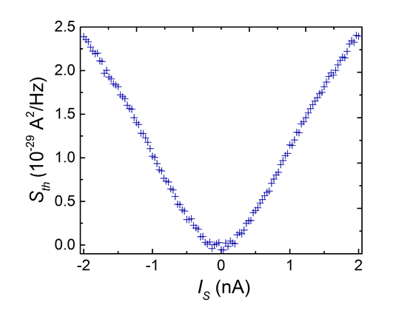
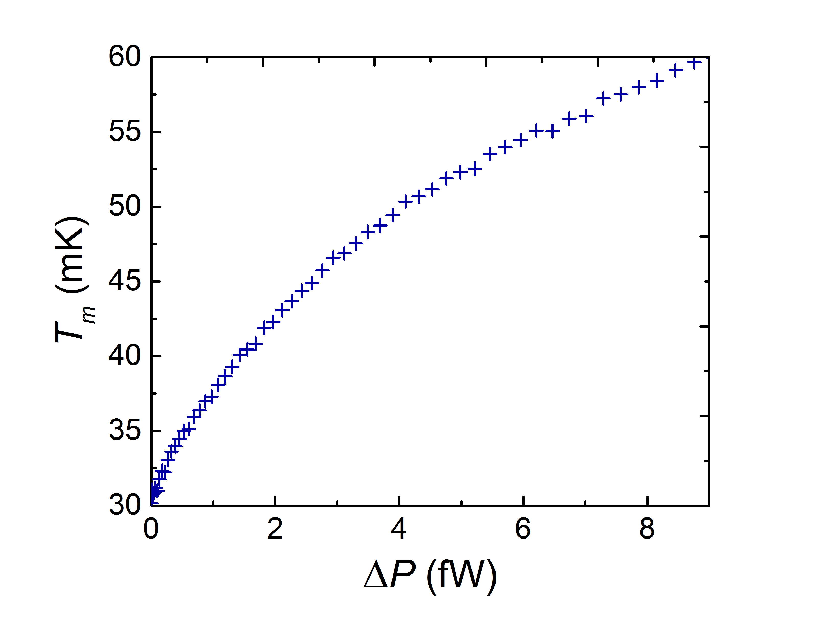
measuring T_{m} ……excess Johnson-Nyquist noise
measured noise

Slide 29
determining thermal conductance
phonons contribution from ‘floating reservoir’ depends ONLY on its T_{m}
when T_{m} large……...subtracting procedure
same T_{m}
phonon contribution subtracted

Slide 30
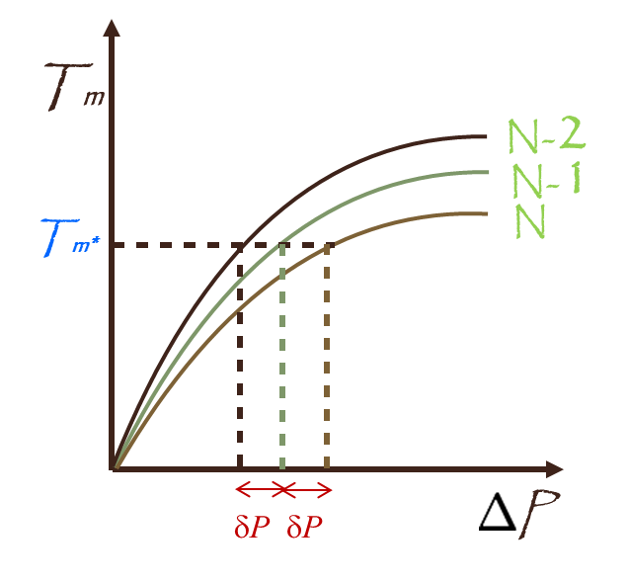
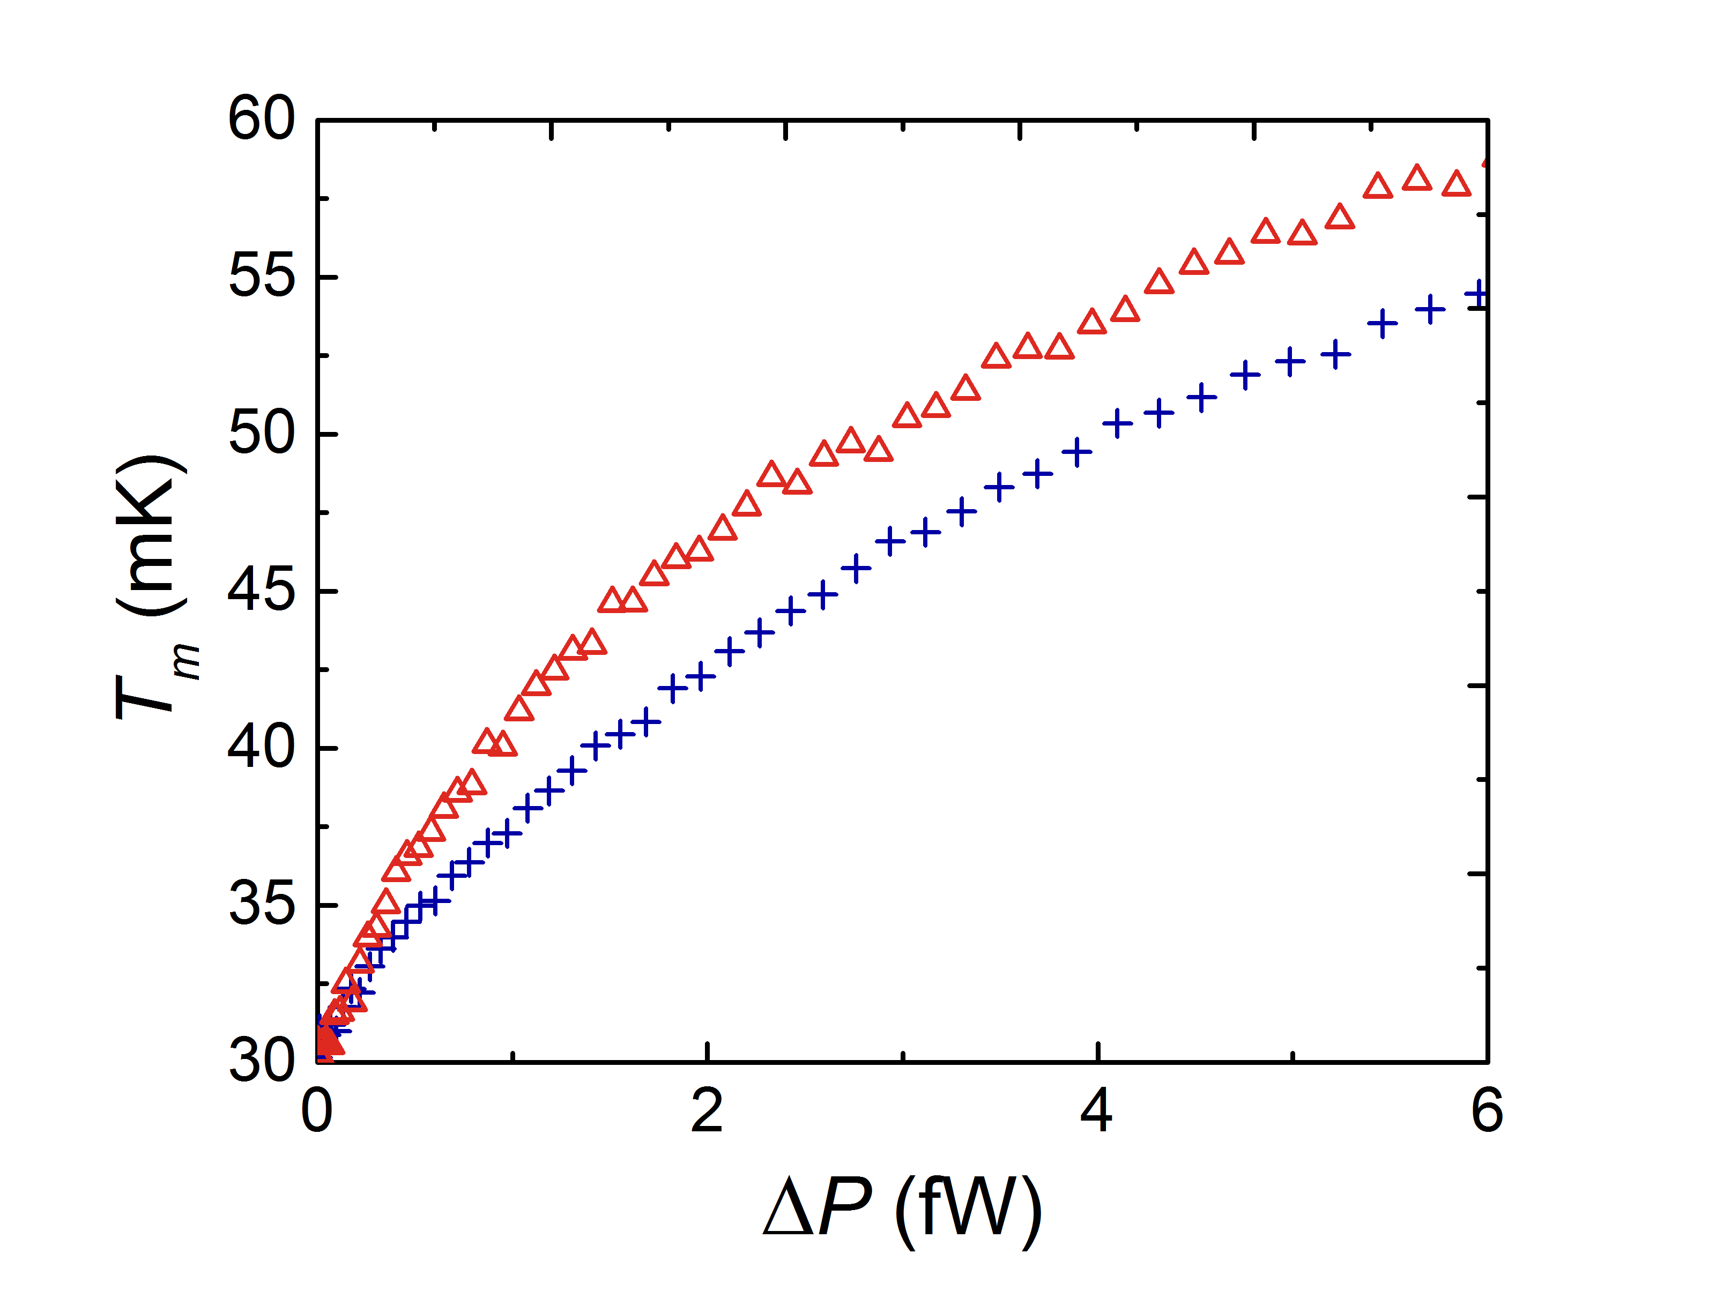
‘phonons contribution’ from ‘floating reservoir’ depends ONLY on T_{m}
when T₀ large……...subtracting procedure
N = 2
N = 4
2 modes

Slide 31

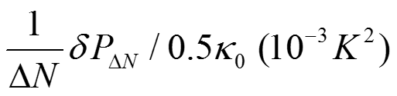
getting K /κ_{0 ……an example}
κ₀
T₀²

Slide 32
realization…….N = 4
QPC2
5µm
QPC1
QPC3
Iin
A
source
QPC4

Slide 33
N = 3
QPC pinched
Iin
A

Slide 34
heart of structure
N =2 v =2 v_{QPC}=1

Slide 35
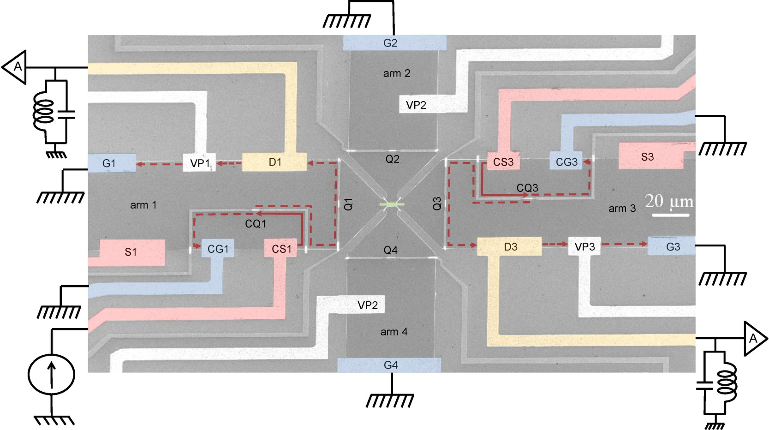
typical structure

Slide 36
points of consideration not an easy experiment
electrons fully equilibrate in the small floating reservoir T_{m}
outgoing charge channels carry only Johnson-Nyquist noise
without shot noise
no presence of bulk energy modes (may increase the apparent thermal conductance)
length of arms is limited (~150µm, temperature equilibration between up-down modes)
equal splitting between arms, amplifier gain determination, contacts’ resistance, …

Slide 37
integers.…………………v = 1, 2
lowest Landau level
particle-like fractions.…..v = 1/3
hole-like fractions……….v = 2/3, 3/5, 4/7
first excited Landau level
v = 7/3, 5/2, 8/3

Slide 38
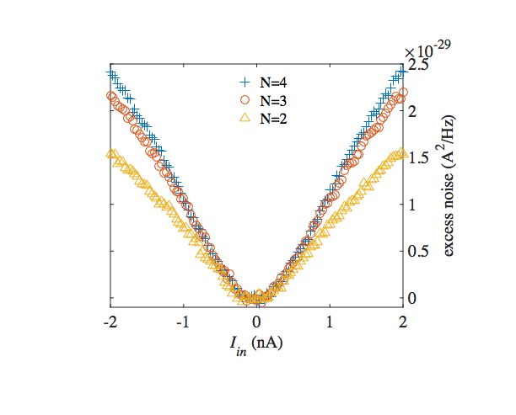
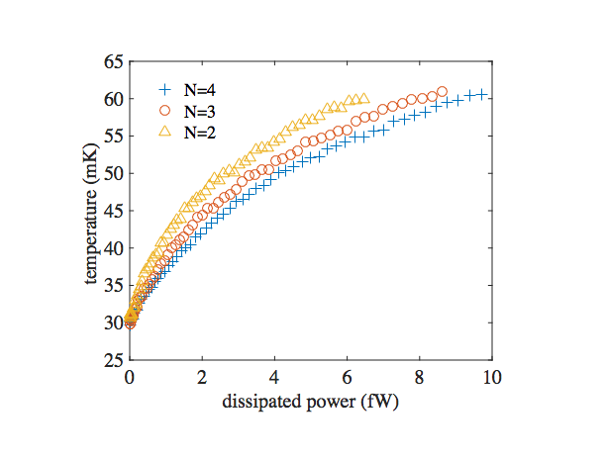
T₀=30mK
phonons subtraction

Slide 40
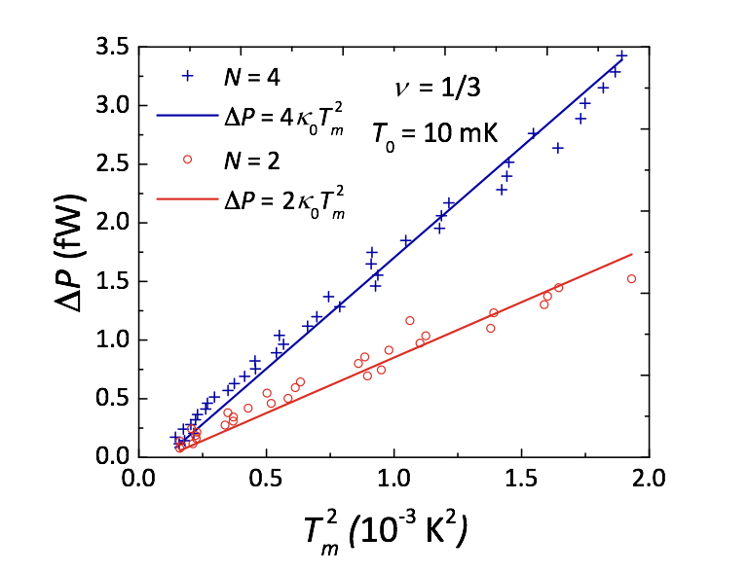
T₀=10mK
v =1/3 → K =κ₀
no phonon contribution

Slide 41
interactions do not affect K
what about K of neutral modes ?

Slide 42
Κ of hole - states…Kane & Fisher 1997
v =2/5 → 2κ₀
predicted….’bulk-edge’ correspondence
2 CF modes
v =2/3 → Κ=0
1 charge down - 1 neutral up
v =3/5 → -κ₀
1 charge down - 2 neutral up
v =4/7 → -2κ₀
1 down charge - 3 neutrals up

Slide 43
v =2/3 …… why Κ = 0 ?
I_{S}
hot upstream neutral mode
hot downstream 2e/3 charge mode
G
T_{m}
G
neutral heat returns
charge heat returns
cold downstream charge mode
cold upstream neutral mode
equal number of down and up modes
full equilibration ONLY at large length…..all emitted heat returns
what is K at short distance ?

Slide 44
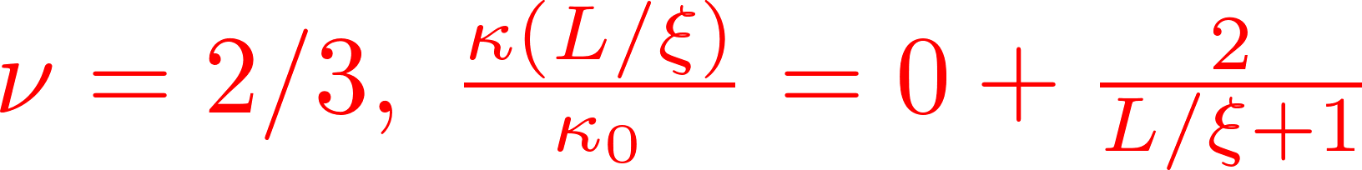



heat conductance w/length

Slide 45
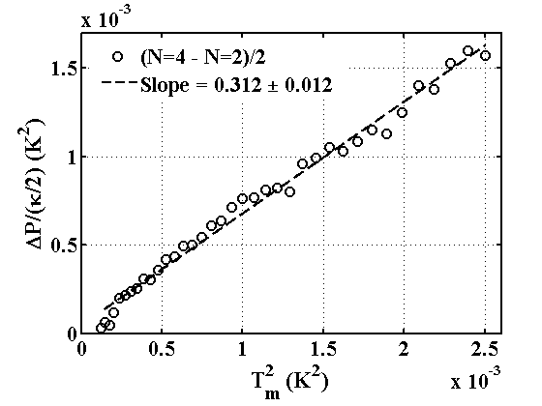
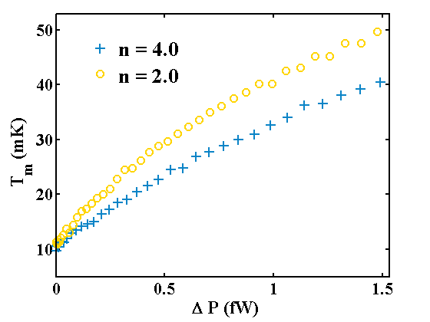
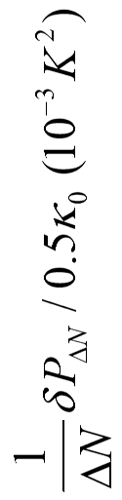
v =2/3 L ~ 150μm
K > 0
ΔN =2
slope=0.33±0.01

Slide 46
v =2/3
T_{m}
d
non-interacting
T₀
u
L
T_{m}
interacting
long equilibration length, ξ
modes do not equilibrate
ξ
T₀
equal number of down and up modes
heat diffuses in v =2/3
length dependence thermal conductance
‘thermal conductivity’

Slide 47



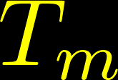
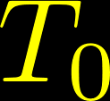
calculating T (x) & Κ …… v =2/3
upper edge
n_{d} =n_{u}=1
Downstream
lower edge
Newton’s law of cooling

Slide 48
e q u i l i b r a t i o n

Slide 49
v =2/3

Slide 50
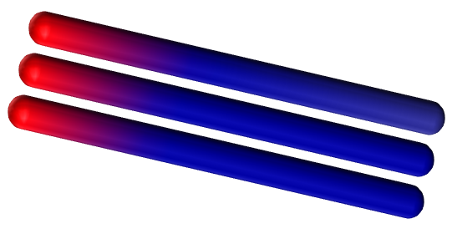
v =3/5
T_{m}
d
T₀
unequal number of down and up modes
T₀
L
shorter ξ
nodes equilibrate fast
ξ

Slide 51
hole-states with more upstream neutral modes
v =4/7 → ⏐-2κ₀ ⏐
v =3/5 → ⏐-κ₀ ⏐
v =2/3 → κ >0

Slide 52
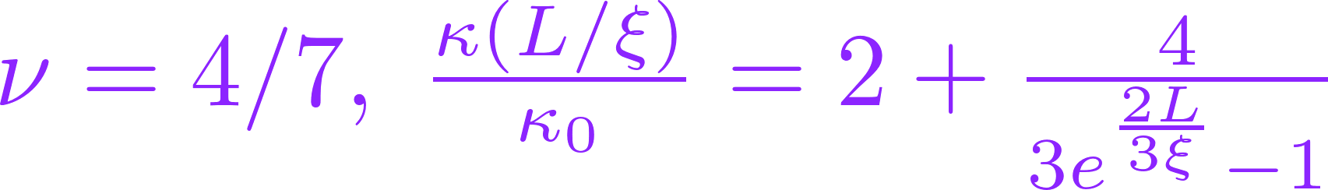
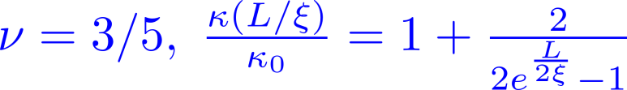
heat conductance w/length

Slide 53
fractional interacting 1D mode
and neutral mode
K = κ₀

Slide 54


Slide 55

first excited Landau level
5/2
PH-Pfaffian
7/3
8/3

Slide 56
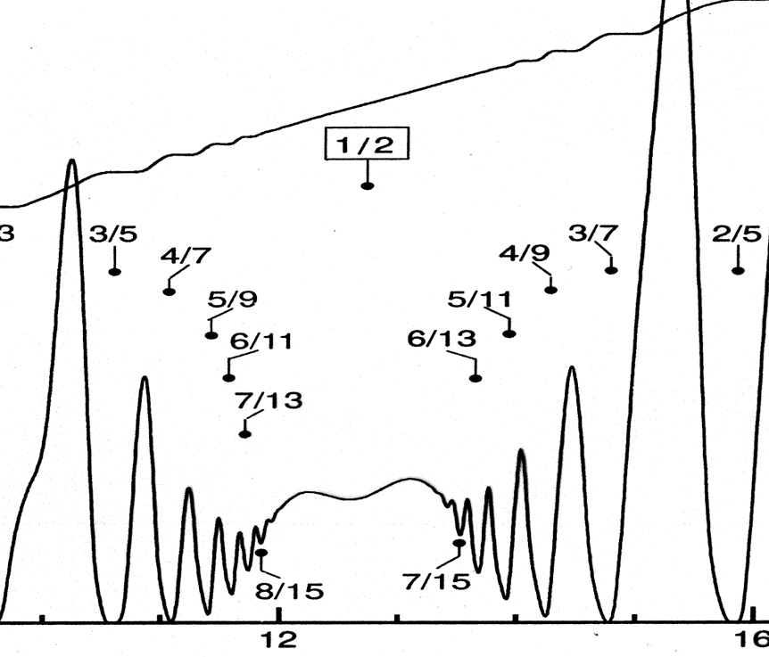

v = 5/2 state
Moore - Read 1991
B* =0
B_{ext}
at v = 5/2……R_{xx}=0
p-wave Cooper pair
BCS of polarized composite fermions
w/ odd orbital angular momentum

Slide 57
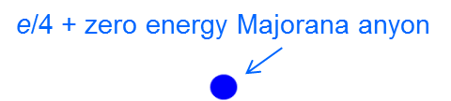
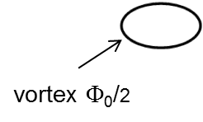
5/2 state Moore – Read, Pfaffian state
bulk – edge correspondence
1D edge liquid of e/4 + Majorana anyon
Majorana → half fermion…. K = κ₀ / 2

Slide 58
already known for v =5/2
charge e /4
upstream neutral modes
spin polarized
abelian or non-abelian ?

Slide 59
abelian
non - abelian
SU(2)₂ |  | κ = 4.5
Pfaffian |  | κ = 3.5
PH - Pfaffian |  | κ = 2.5
Anti - Pfaffian |  | κ = 1.5
Anti - SU(2)₂ |  | κ = 0.5
331 |  | κ = 4
K =8 |  | κ = 3
113 |  | κ = 2
Anti-331 |  | κ = 1
integer, e, κ = 1
fraction, e/4, κ = 1
neutral, 0, κ = 1
Majorana, 0, κ = 0.5

Slide 60
composite fermions (CFs) model
Jain, 1989
flux attachment
2Φ₀
composite fermion
Φ₀ Φ₀
B
e⁻
B_{1/2}
n_{e}
e
Fermi liquid of correlated electrons at B_{1/2}
external field canceled
mean field approximation
B_{1/2}
CFs feel a reduced lower field, B –B _{1/2}
expected to be independent particles
B _{1/2} = 2n_{e}Φ₀

Slide 61
bulk ‘zero energy’ Majorana anyons
B –B_{1/2} >0 induces vortices in bulk
zero energy quasiparticle (Majorana) in vortex + e /4
Majorana’s come in pairs…..forming fermionic state γ₁ ± i γ₂
ground state degeneracy of n vortices……. 2^{n / 2} (non-abelian)

Slide 62
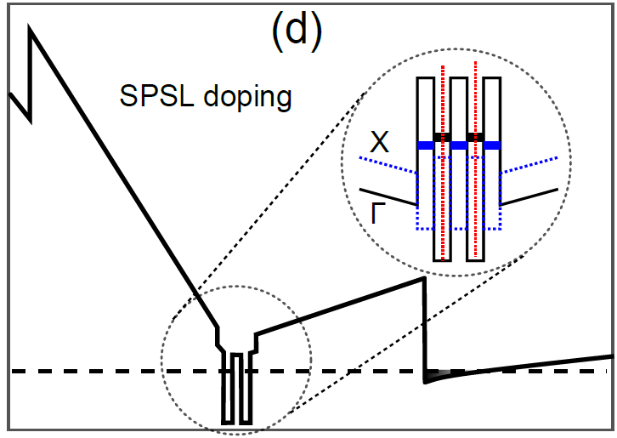
doping for X-high mobility 2DEG
5/2 state affected by long-range scattering from ionized dopants
improve spatial correlation & screening via excess free electrons at donor layers
Pfeiffer, 2000’s
short period AlAs/GaAs super-lattice (SPSL)

Slide 63
difficulties in 5/2 material
‘bulk heat conductance’…..free electrons in donor layers
poor contact of floating reservoir – reflections
instability and hysteresis of QPC’s

Slide 64
  measured
  v =7/3 v = 2 + 1/3 particle like, downstream K = 3κ₀
v =8/3 v = 2 + 2/3 hole-like, down - up K = (2+ε)κ₀
  v =5/2

Slide 65
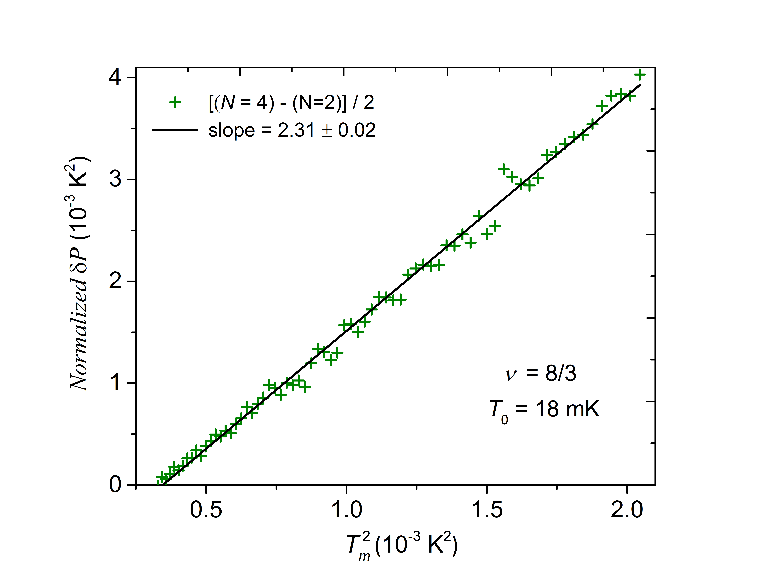

Slide 66
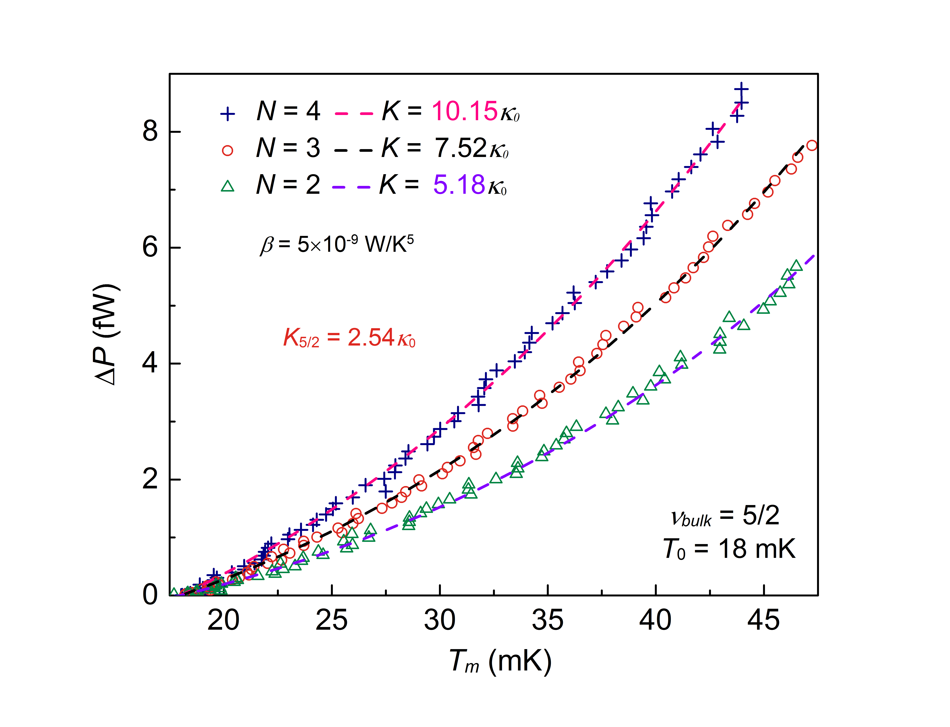
conductance determination with
estimated phonons contribution

Slide 67
thermal cycling
17 measurements
different temperatures
different locations on the v=5/2 plateau

Slide 68
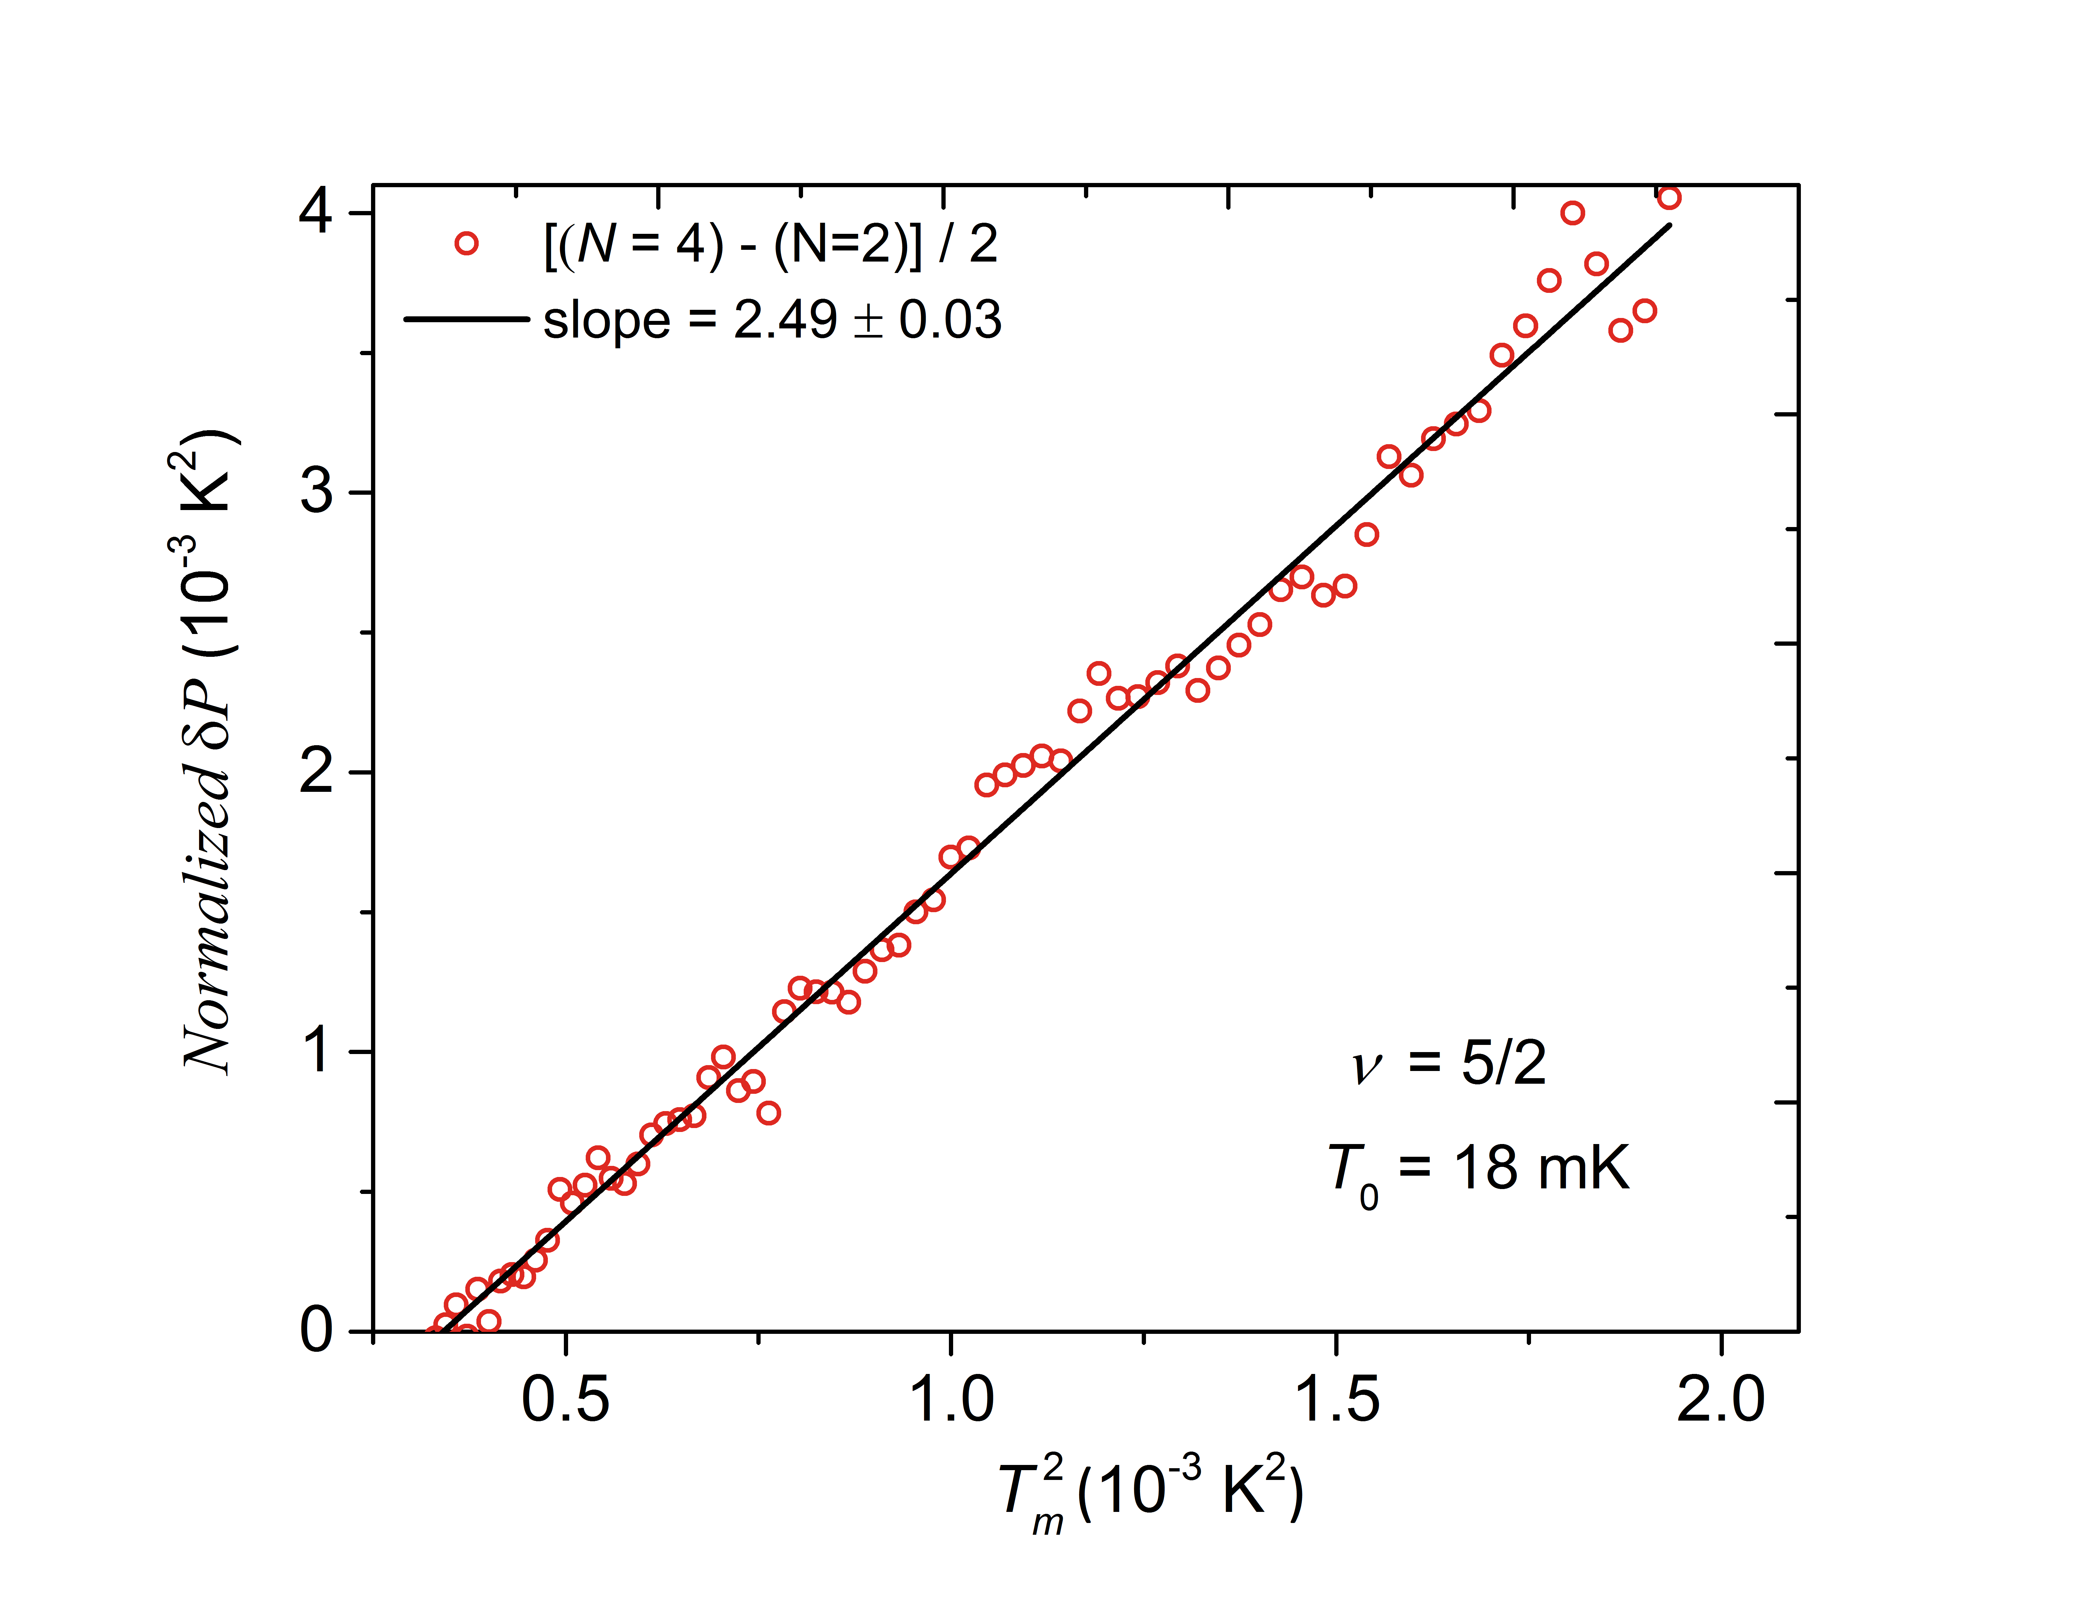
thermal conductance determination via
‘subtraction procedure’
ΔN = 4 - 2

Slide 69
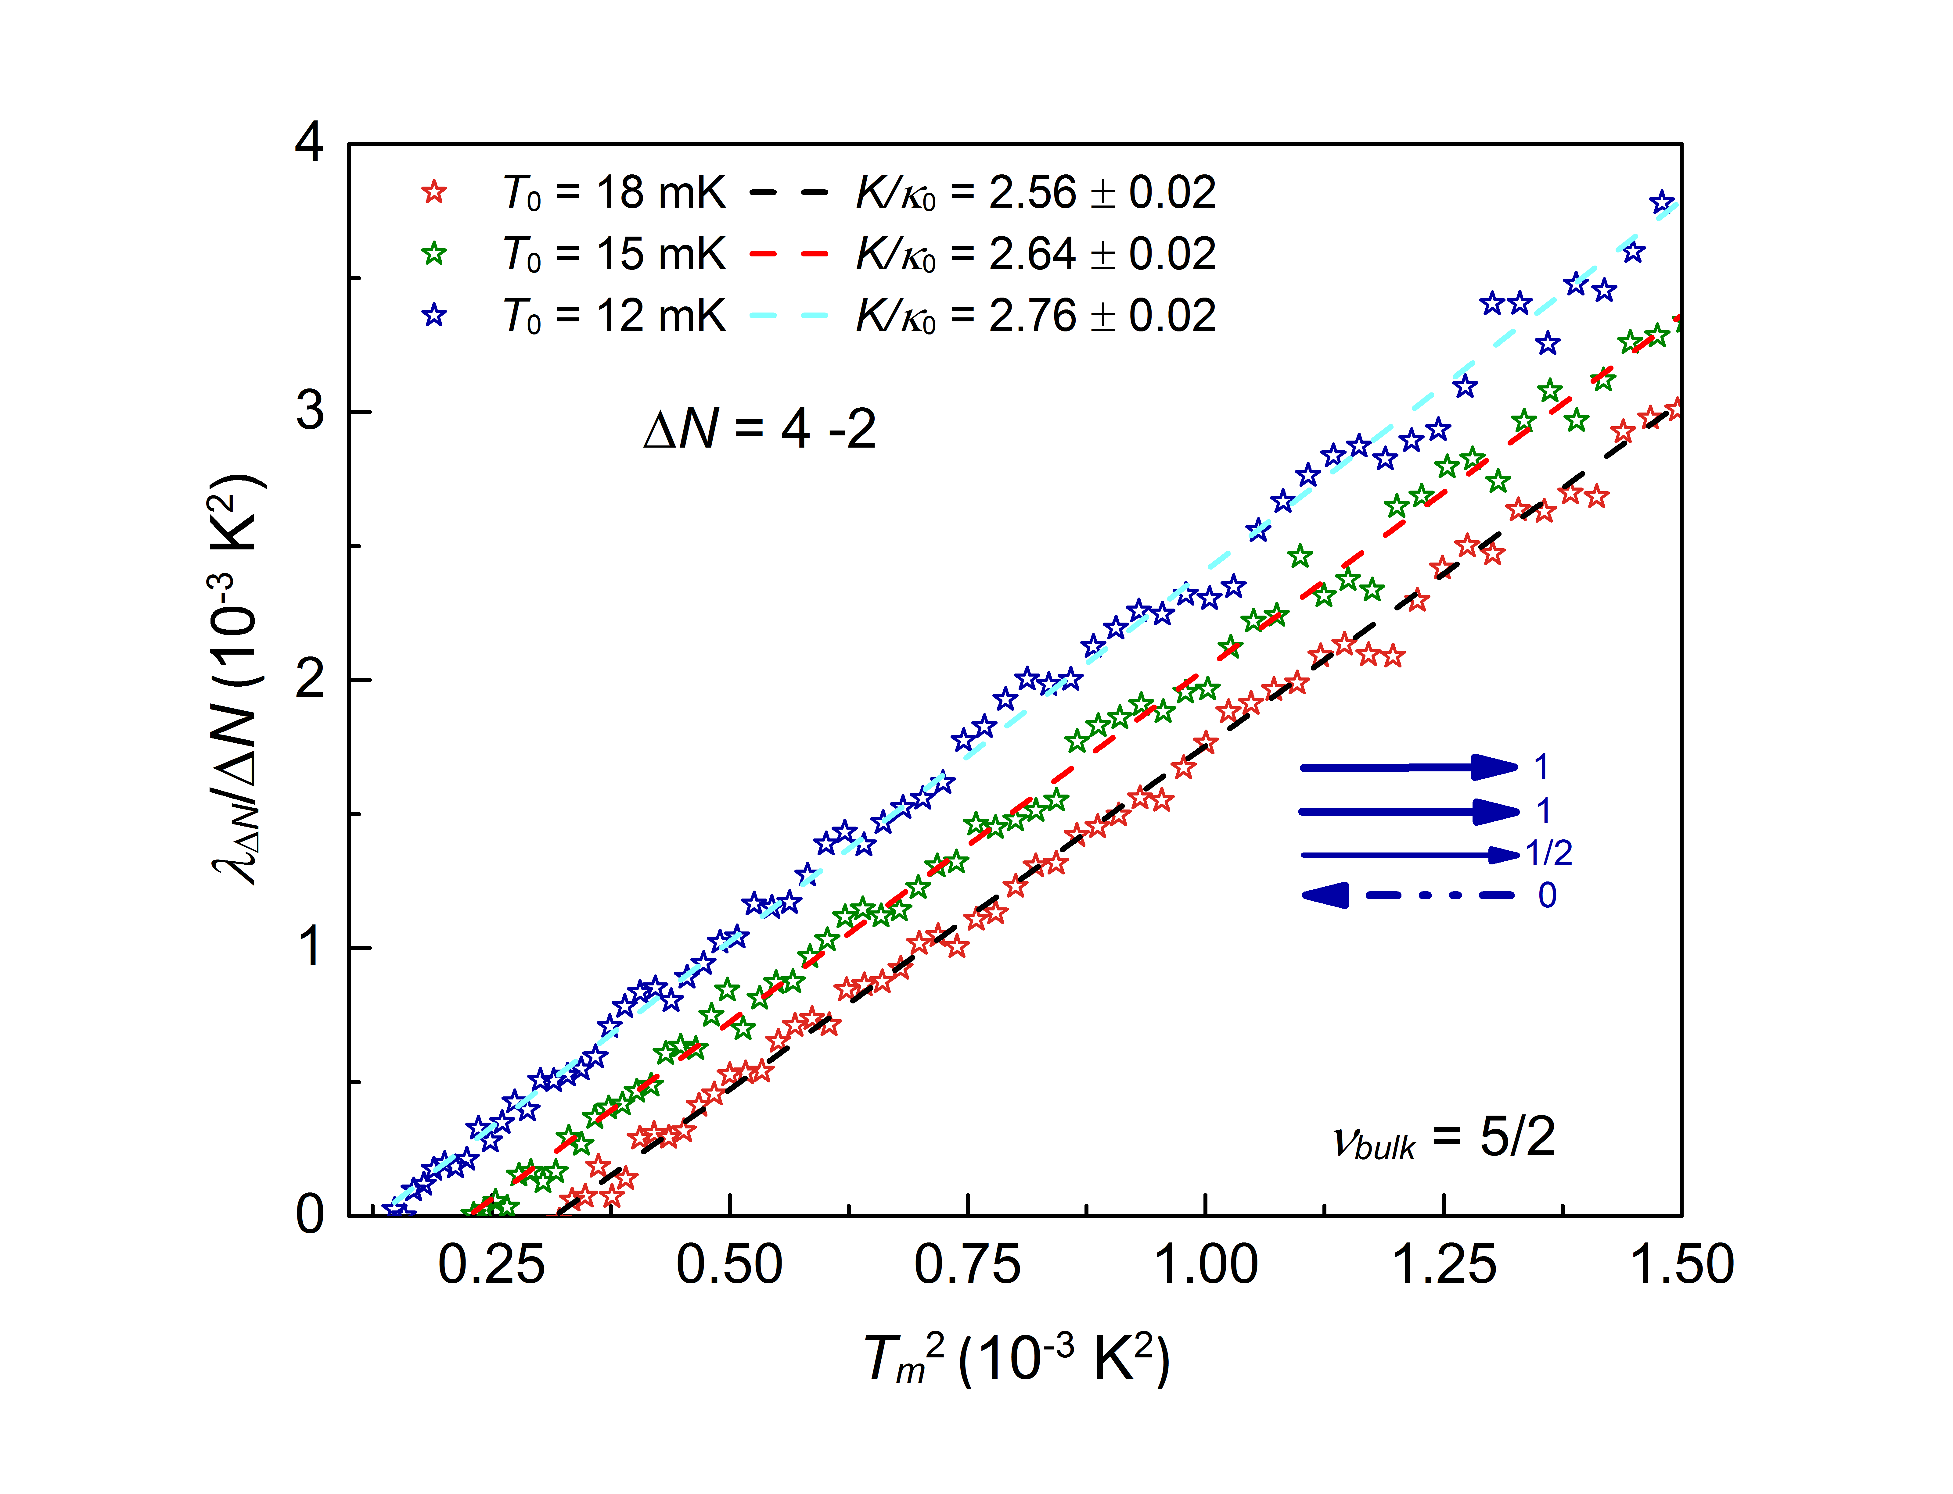

Slide 70
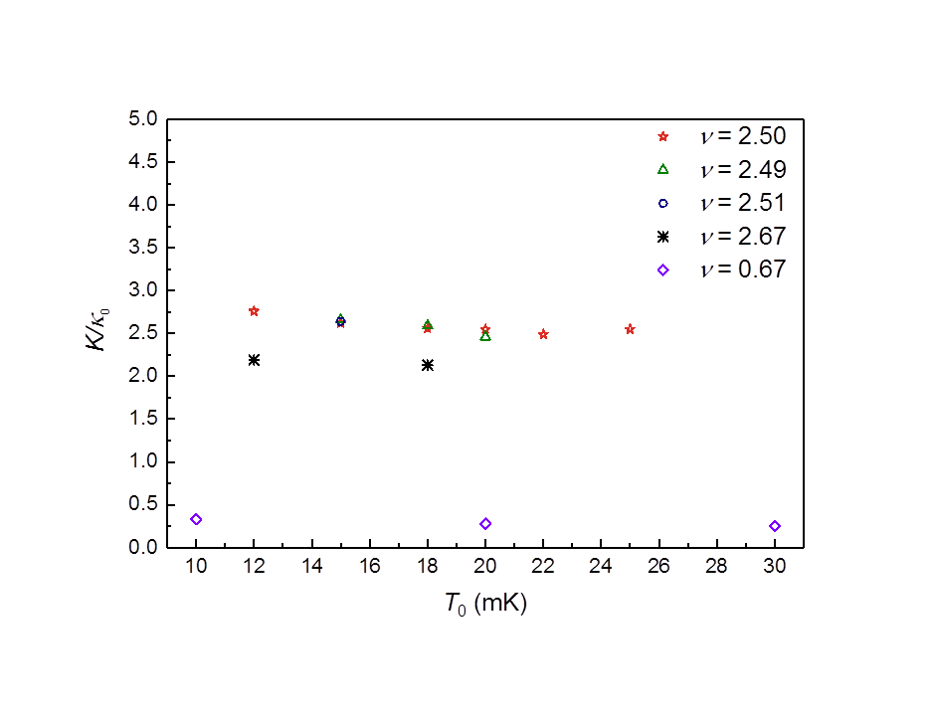
SU(2)₂
increasing equilibration length at lower temperature
Pfaffian
PH-Pfaffian
PH - Pfaffian
equilibrated
v=8/3
Anti - Pfaffian
Anti - SU(2)₂
v=2/3

Slide 71
abelian
non - abelian
SU(2)₂ |  | κ = 4.5
Pfaffian |  | κ = 3.5
PH - Pfaffian |  | κ = 2.5
Anti - Pfaffian |  | κ = 1.5
Anti - SU(2)₂ |  | κ = 0.5
331 |  | κ = 4
K =8 |  | κ = 3
113 |  | κ = 2
Anti-331 |  | κ = 1
integer, e, κ = 1
fraction, e/4, κ = 1
neutral, 0, κ = 1
Majorana, 0, κ = 0.5

Slide 72
5/2
PH-Pfaffian
7/3
8/3
3κ₀
2.5κ₀
2.15κ₀

Slide 73
v = 5/2……..non-abelian
measuring thermal conductance
reveals hidden information

Slide 75






Mitali Banerjee Amir Rosenblatt Yuval Oreg Ady Stern Dima Feldman Vladimir Umansky

Slide 76
5/2
8/3

Slide 77
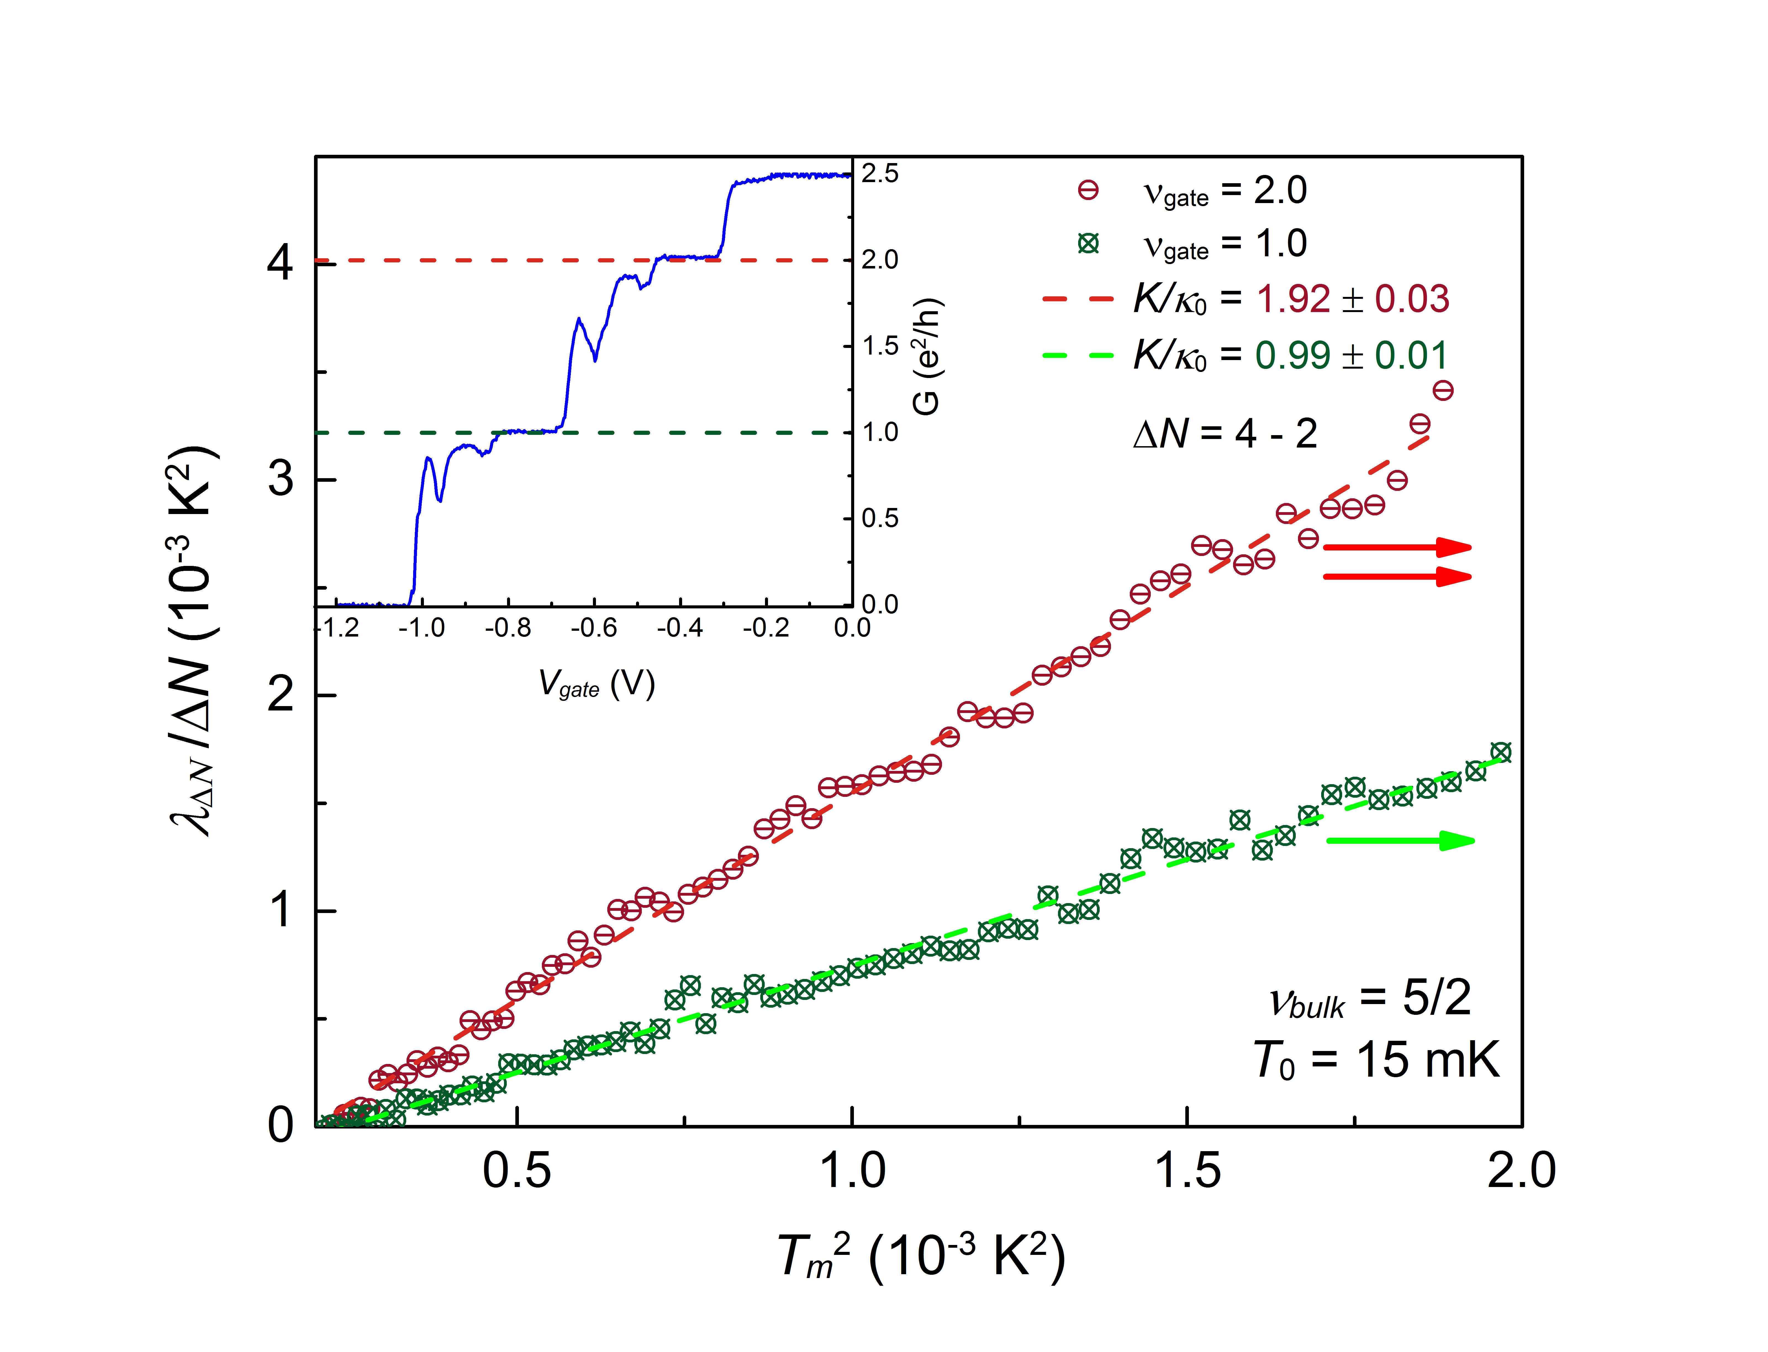
measuring v =1,2 @ v_{B}=5/2

Slide 78
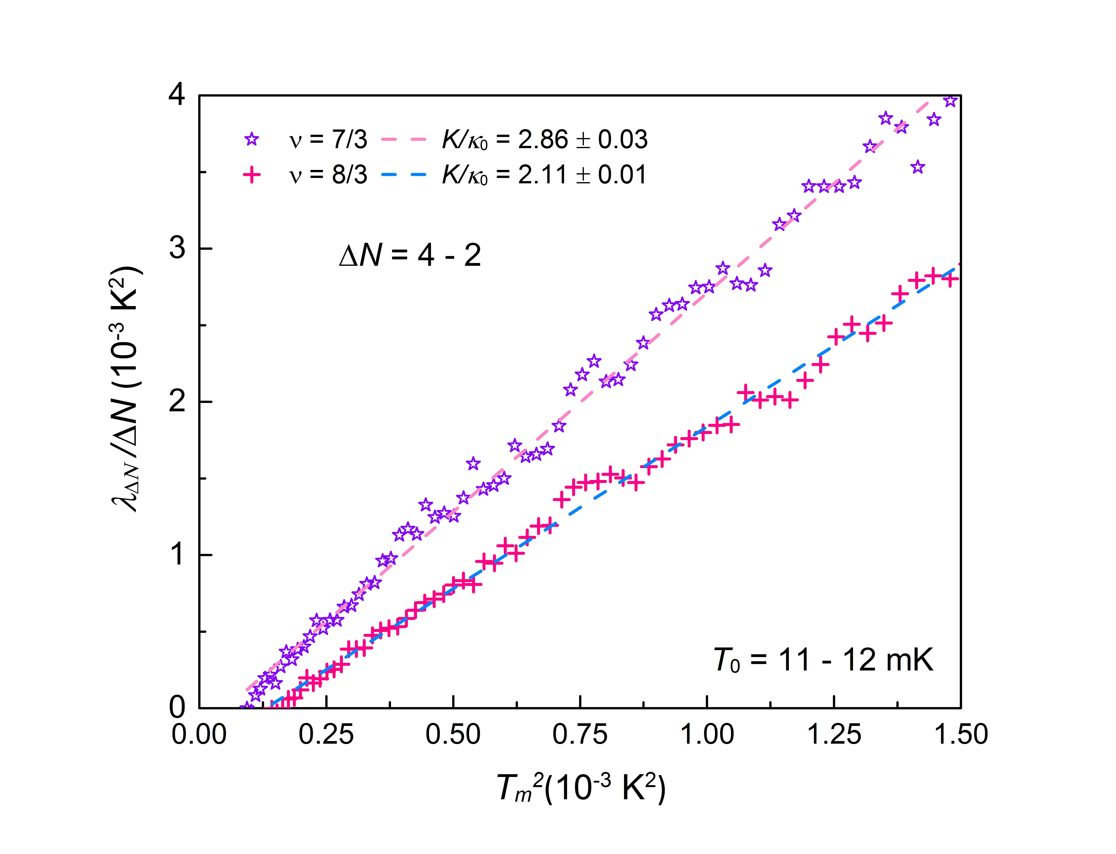
~3
~2

Slide 79
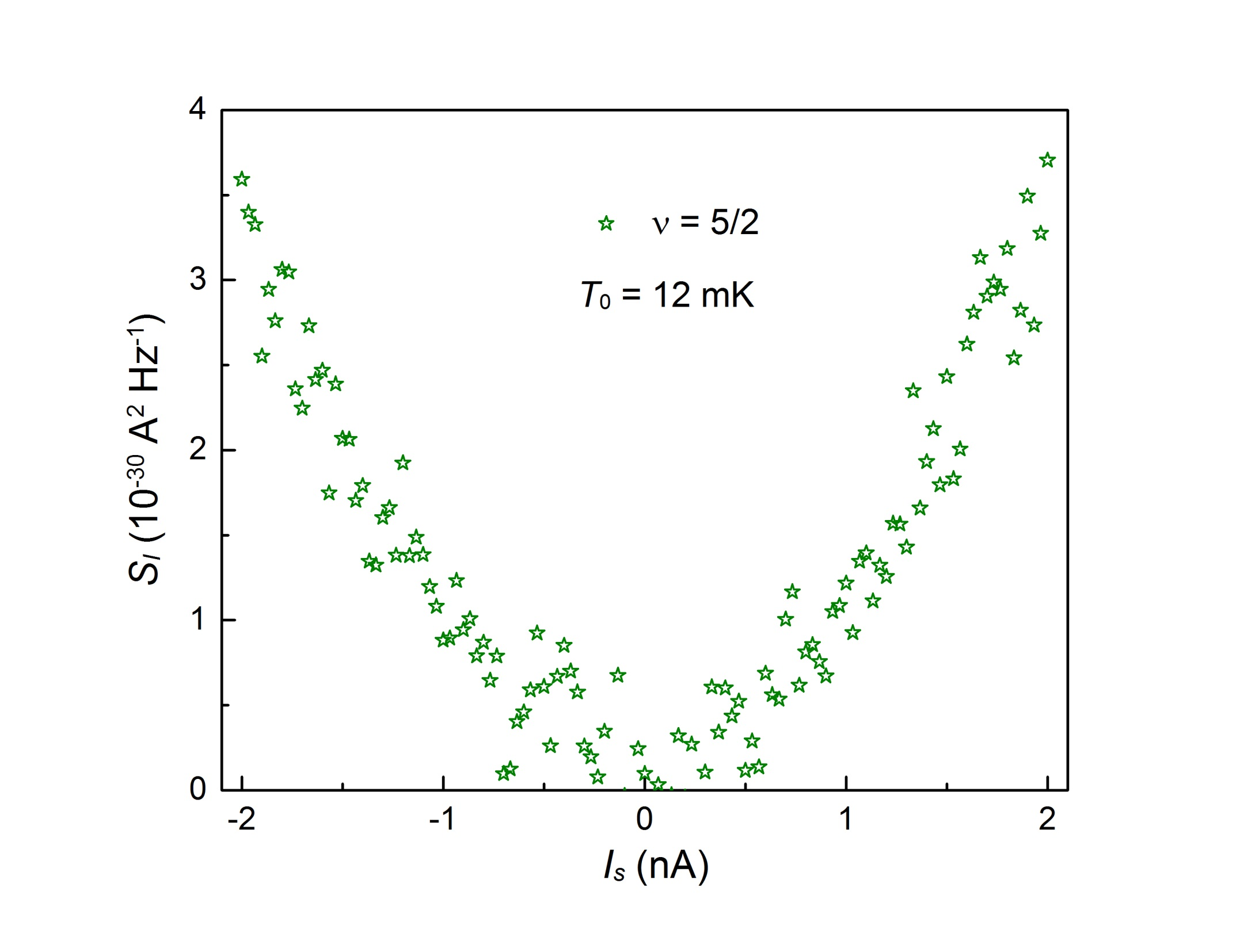
Neutral Noise

Slide 80
zero energy Majorana anyons
B –B_{1/2} >0 induces vortices in the p-wave BCS condensate
zero energy quasiparticle (Majorana) in vortex + e /4
Majorana - chargeless and spinless
Majorana’s come in pairs…..forming fermionic state γ₁ ± i γ₂
occupied & unoccupied at zero energy
ground state degeneracy of n vortices……. 2^{n / 2}

