Slide 1



Magnetic Ordering on Topological Crystalline Insulator Surfaces
Part 1. 3D topological insulators and their surface states
Part 2. Ordering on the surface of magnetically doped TCI’s
Part 3. Domain walls and speculations
Sahinur Reja - Indiana
Luis Brey – CSIC, Madrid
Shixiong Zhang - Indiana

Slide 2
3D Topological Insulators
I. Surface states protected by time-reversal symmetry
Paradigm: Bi_{1-x}Sb_{x}
Projection of time-reversal invariant points onto surface
guaranteed to be doubly degenerate (“Kramer’s doublet”)
Away from these points states repel ⇒ surface Dirac cone
“Surface Brillouin zone”:
Gapless nature of surface states robust: protected by
time-reversal symmetry
From Hassan and Kane, RMP (2010)

Slide 3
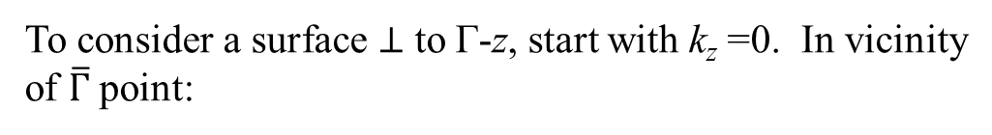
Model Hamiltonian for Bi₂Se₃ (Zhang et al. 2009):
(111) surface
(Figs from Zhang et al., Nat. Phys. 2009)
Four relevant orbitals at Γ point:
To consider a surface ⊥ to Γ-z, start with k_{z} =0. In vicinity
of $\overline{Γ}$ point:
Hybridized p_{z} orbitals of basis atoms
$$H\left(k_{x},k_{y},0\right)=\left[M_{0}−B_{2}\left(k_{x}^{2}+k_{y}^{2}\right)\right]τ_{z}σ_{0}+A_{2}\left({τ_{x}σ}_{x}k_{x}+{τ_{x}σ}_{y}k_{y}\right)$$

Slide 4
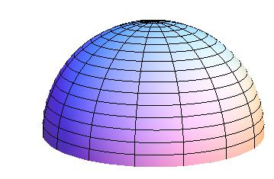
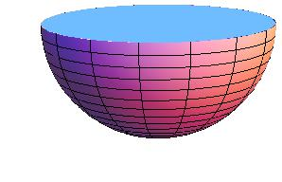
$$H\left(k_{x},k_{y},0\right)=\left[M_{0}−B_{2}\left(k_{x}^{2}+k_{y}^{2}\right)\right]τ_{z}σ_{0}+A_{2}\left({τ_{x}σ}_{x}k_{x}+{τ_{x}σ}_{y}k_{y}\right)$$
Mutually anticommuting, like Pauli matrices
Coefficients may represent 3D vector components
of k – dependent “Zeeman” Hamiltonian
For M₀B₂ > 0, the origin is enclosed ⇒ Topological insulator
So gapless surface states can be constructed.
Can do so explicitly with this form of H.
[Liu et al. (2010); Silvestrov et al. (2012), Brey and HAF (2014)]

Slide 5
Example:
Rectangular slab in a magnetic field
Lateral surface
Perpendicular surface
E_{F}
Observations:
E_{F}
For narrow slab, can get ν = 1 QHE from
two surfaces with Landau levels
σ_{xy}= (1/2)e²/h per surface
2. For thicker slabs, M left-movers, M+1 right movers
⇒ Need disorder or dephasing to get correct Hall quantization
(Brey and HAF, PRB 2014)

Slide 6
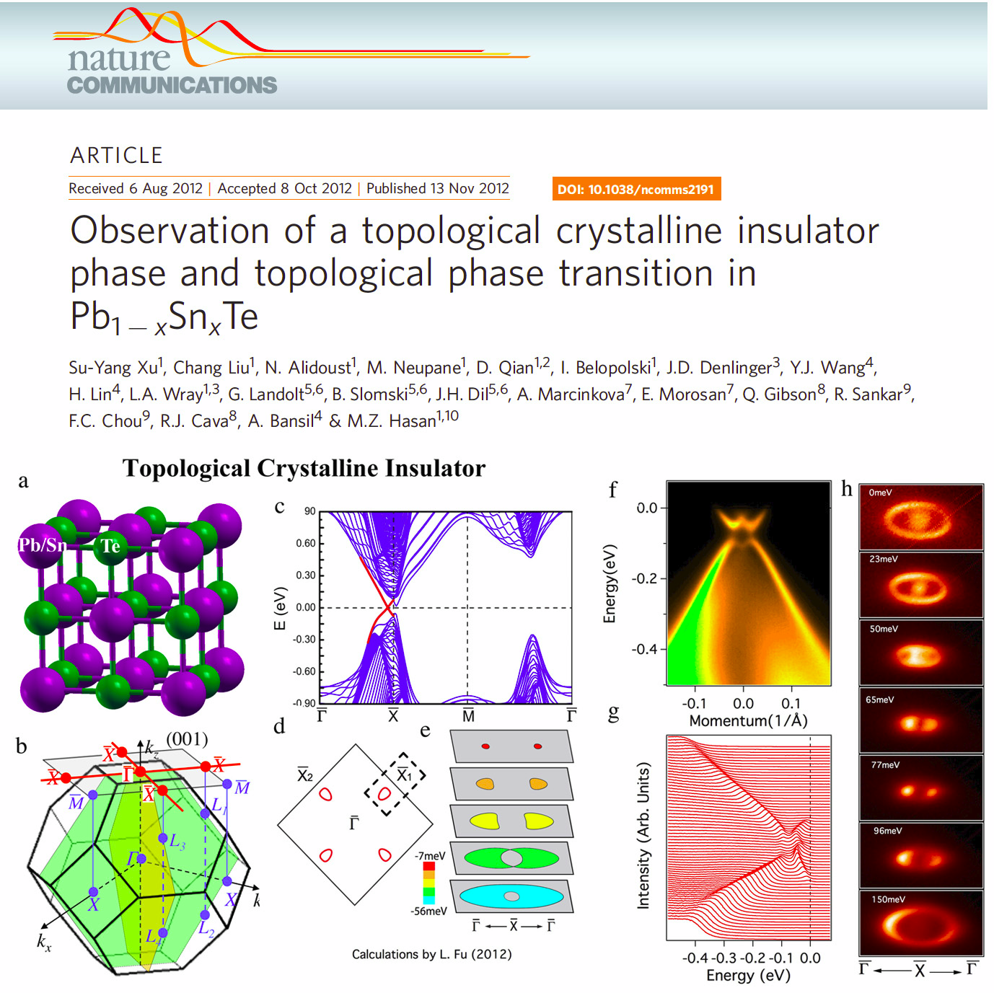
II. Surface states protected by crystalline symmetry:
Topological crystalline insulators (TCI)
(Liang Fu, MIT)
Paradigm: Sn_{1-x}Pb_{x}Te
Surface states protected by mirror symmetry
Semiconductors, “standard model” has 12 orbitals
Direct gaps at L points (4 of these)
L points are special:
1. H_{nn}(k=L) = 0  Sublattice a good quantum number
2. Γ – L direction hosts 3-fold rotational symmetry
3. Γ – L direction hosts 3 mirror planes
Pb/Sn sites have effectively adjustable on-site energies
controlled by x: “virtual crystal approximation”
⇒ System can be adjusted through topological transition!

Slide 7
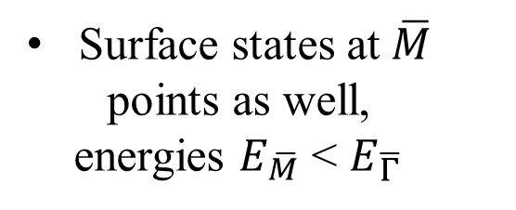
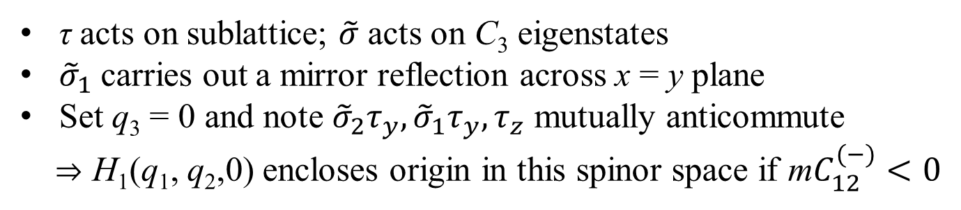




Continuum bulk Hamiltonian near L point with Γ – L perpendicular to (111) surface:
$$E_{\overline{M}}$$
τ acts on sublattice; $\tilde{σ}$ acts on C₃ eigenstates
${\tilde{σ}}_{1}$ carries out a mirror reflection across x = y plane
Set q₃ = 0 and note ${\tilde{σ}}_{2}τ_{y}, {\tilde{σ}}_{1}τ_{y}, τ_{z}$ mutually anticommute
⇒ H₁(q₁, q₂,0) encloses origin in this spinor space if m$C_{12}^{(−)}<0$
q₂
$$E_{\overline{Γ}}$$
q₃ out
q₁
$$E_{\overline{M}}$$
$$E_{\overline{M}}$$
BZ face perpendicular to k₁
⇒ possible to construct gapless surface states
Surface states at $\overline{M}$
points as well,
energies $E_{\overline{M}}$ < $E_{\overline{Γ}}$
Projection of H₁(q) onto these states to linear order:
⇒ 4 Surface Dirac cones! (Hsieh et al, 2012)

Slide 8
Confirmation in ARPES …
… and tight binding calculations.
E/t
(Polley et al., 2014)

Slide 9
Magnetic Impurities and Magnetism in TCI Systems
(Sn,Pb)Te doped with sufficient magnetic impurity (Mn,Eu) concentration long-known to be ferromagnetic
Impurities substitute for (Sn,Pb)
Hole-doped semiconductors: impurity
spins interact with bulk carriers holes via
ferromagnetic exchange
Story et al, 1990
If conduction electrons removed (e.g., compensation doping), impurity spins become decoupled and no magnetism. But if the system is a TCI, what happens at the surface?
E_{F}
Levels repel if mirror symmetry breaks

Slide 10

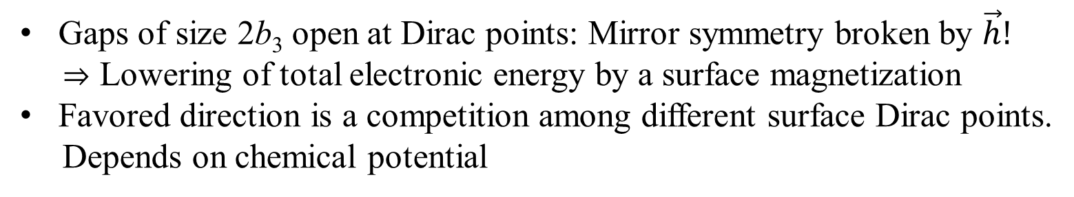
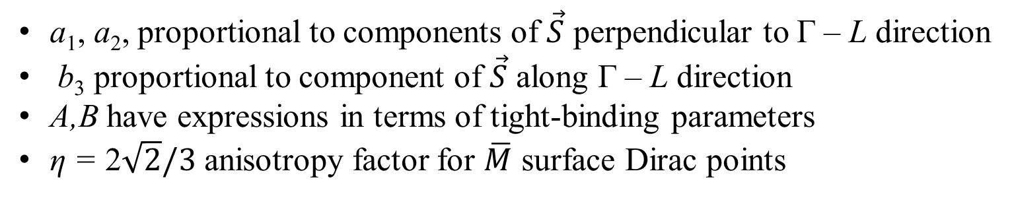
Mean-field approach: suppose impurity spins are uniformly polarized: ${\vec{s}}_{i}=$ constant
$$H_{c}⟶ −\vec{h}⋅ \vec{S}$$
a₁, a₂, proportional to components of $\vec{S}$ perpendicular to Γ – L direction
b₃ proportional to component of $\vec{S}$ along Γ – L direction
A,B have expressions in terms of tight-binding parameters
η = 2$\sqrt{2}/3$ anisotropy factor for $\overline{M}$ surface Dirac points
Gaps of size 2b₃ open at Dirac points: Mirror symmetry broken by $\vec{h}!$
⇒ Lowering of total electronic energy by a surface magnetization
Favored direction is a competition among different surface Dirac points.
Depends on chemical potential

Slide 11
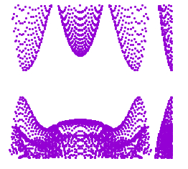
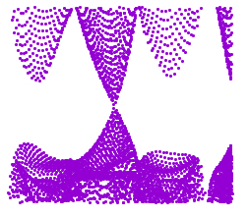




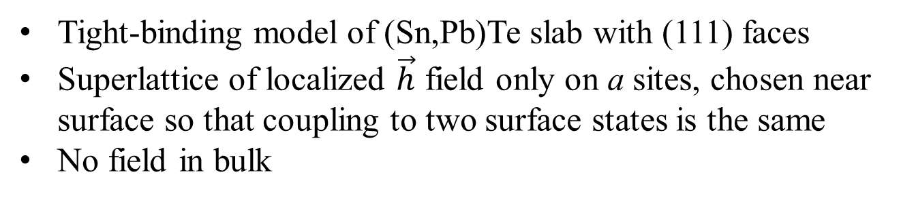

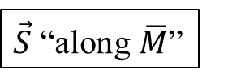
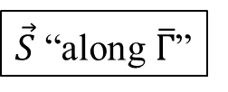



Numerical Simulations: Total energy calculations
(111) face
Tight-binding model of (Sn,Pb)Te slab with (111) faces
Superlattice of localized $\vec{h}$ field only on a sites, chosen near surface so that coupling to two surface states is the same
No field in bulk
E
$$\overline{M}$$
$$\overline{Γ}$$
$$\overline{M}$$
$$\overline{M}$$
$$\overline{M}$$
$$\overline{Γ}$$
$$\overline{M}$$
$$\overline{M}$$
$\vec{S}$ “along $\overline{Γ}$”
$\vec{S}$ “along $\overline{M}$”

Slide 12





Total (free) energy computed for different $\vec{h}$ orientations
Free difference between $\overline{Γ}$ and $\overline{M}$ orientations
h =
Fixed N
Fixed µ
$\vec{h}$ on 2/9 of sites
E_{F}~$E_{\overline{M}}$
E_{F}~$E_{\overline{Γ}}$
All $\vec{h}$ same within a layer.
-
+
-
+
So direction of magnetization can be manipulated using an electric gate!
-
+
-
+
-
+
-
+

Slide 13

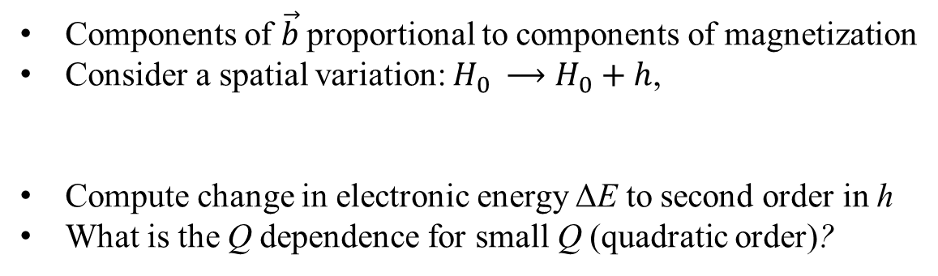

Checking ferromagnetism: Does energy increase when spins not aligned?
$${\vec{s}}_{2}$$
1. Numerical (spin stiffness at short distance)
$${\vec{s}}_{1}$$
2. Perturbation theory (long distance)
Consider a generic gapped Dirac surface Hamiltonian (ignore anisotropy)
Components of $\vec{b}$proportional to components of magnetization
Consider a spatial variation: $H_{0 }⟶H_{0}+h$,
Compute change in electronic energy ΔE to second order in h
What is the Q dependence for small Q (quadratic order)?

Slide 14
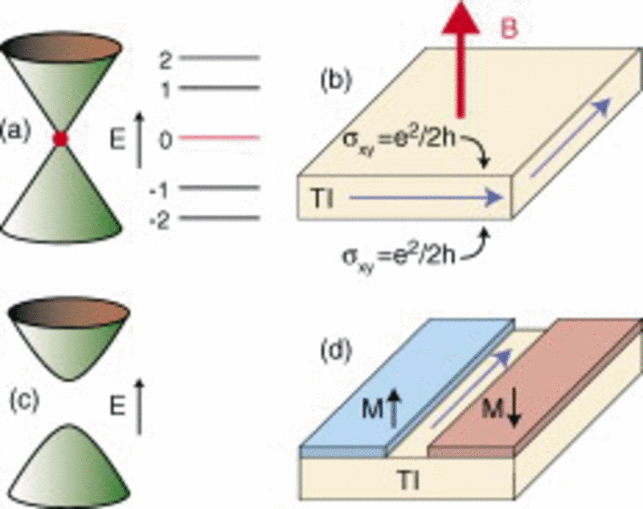

Two situations:
Fermi surface present, result is independent of Q!
⇒ Impurity spins are “floppy”
E_{F}
(b) When E_{F} is in the gap,
Δ⁽⁰⁾
E_{F}
$$ρ_{μ,ν}\sim 1/Δ^{(0)}$$
As Δ⁽⁰⁾ → 0, spin-spin interaction becomes long-ranged
.
Compare to graphene spin susceptibility χ(Q) (Brey, HAF, Das Sarma, PRL 2007)
(1) For µ in-band, χ(Q) independent of Q for small Q
(2) For Q at Dirac point, χ(Q) ~ Q ⇒ 1/r³ RKKY interaction
Because Δ⁽⁰⁾ ~ $\overset{⃑}{h}$ along Γ – L direction, impurity spins become stiff as system thermally disorders at high T!

Slide 15
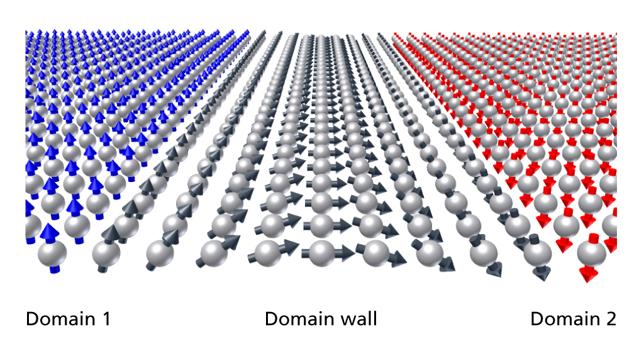
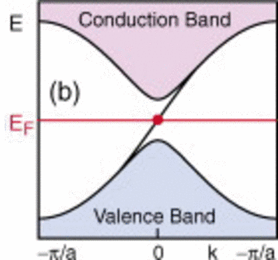
III. Domain Walls and Thermal Disordering
Simple model of surface magnetization $\vec{h}$: $H\left[\vec{h}\right]=E_{n}\left[\vec{h}\right]+$(appropriate spin stiffness)
Number of energy minima
e.g., two-fold symmetry
Δ⁽⁰⁾ ~ b₃
Δ⁽⁰⁾ ~ -b₃
ΔC₁ = 1: Jackiw-Rebbi mid-gap
states
Number of channels depends on how many b₃’s change sign: Up to 4 possible!
C₁ = 1/2
C₁ = -1/2
From zero-field cooling or in thermal equilibrium
Look for effects of increased conduction: tunneling, surface conductance, surface reflectance

Slide 16
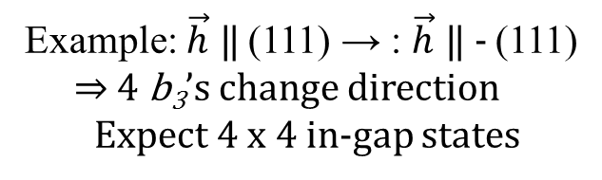


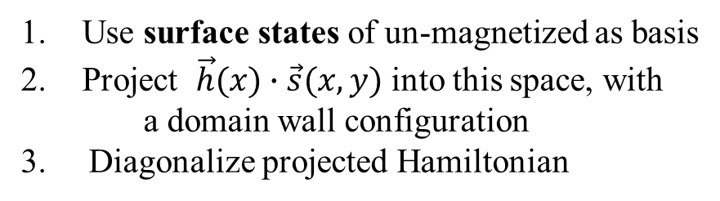
Domain Walls for TCI:
Example: $\vec{h}$ ‖ (111) → : $\vec{h}$ ‖ - (111)
⇒ 4 b₃’s change direction
Expect 4 x 4 in-gap states
Use surface states of un-magnetized as basis
Project $\vec{h}(x)∙\vec{s}(x,y)$ into this space, with
a domain wall configuration
3. Diagonalize projected Hamiltonian
${\vec{k}}_{2}$ a good quantum number
4. Periodic b.c. ⇒ two DW’s per unit cell, per surface
${\vec{k}}_{1}$ a good quantum number

Slide 17
Does the presence of in-gap states change the long-range interaction? No.
3-d Coulomb-like interaction among spin gradients.
Numerical evidence from graphene:
DW’s in staggered magnetization
L
µ in gap
µ in gap
Δ₀
DW
DW
x
µ in band
µ in band
Expect logarithmic interaction!

Slide 18
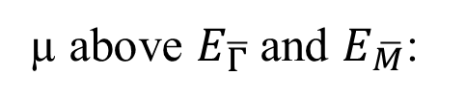
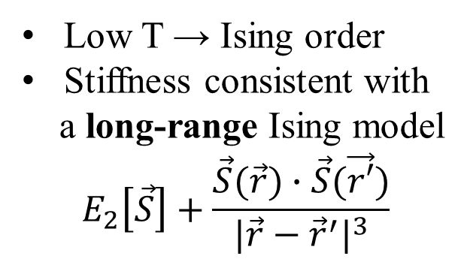
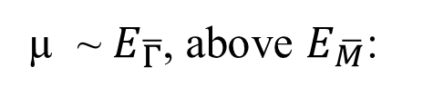
1.
µ above $E_{\overline{Γ}}$and $E_{\overline{M}}$:
⇒ Thermal disordering
transition in Ising class
µ
Low T → Ising order
DW’s: finite energy
per unit length
2.
µ ~ $E_{\overline{Γ}}$, above $E_{\overline{M}}$:
⇒ Thermal disordering
transition with
mean-field exponents
[M.F. Paulos et al., Nuc. Phys. B (2016)]
Low T → Ising order
Stiffness consistent with
a long-range Ising model
$$E_{2}\left[\vec{S}\right]+\frac{\vec{S}(\vec{r})∙\vec{S}(\vec{r′})}{{|\vec{r}−{\vec{r}}^{′}|}^{3}}$$
µ

Slide 19
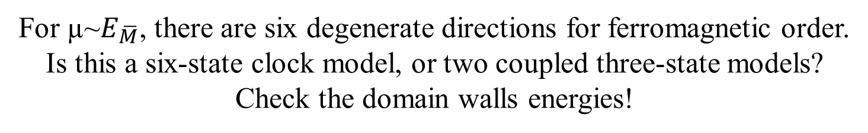
For µ~$E_{\overline{M}}$, there are six degenerate directions for ferromagnetic order.
Is this a six-state clock model, or two coupled three-state models?
Check the domain walls energies!
S = 0.01t
ΔE = E(L₂ →L₃)- E(L₂ →L₁)
always negative
S = 0.1t
⇒ six-state model

Slide 20
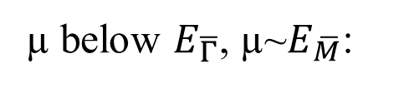
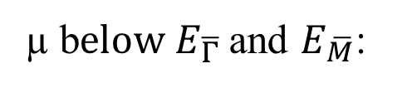
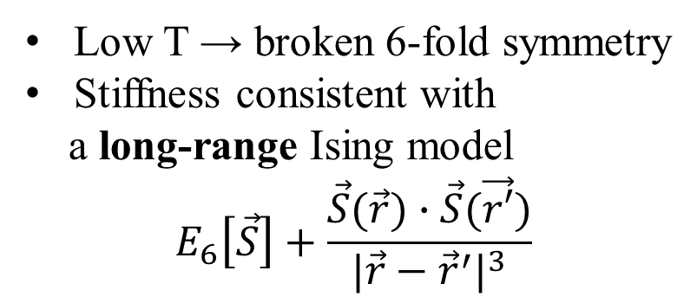
3.
µ below $E_{\overline{Γ}}$, µ~$E_{\overline{M}}$:
⇒ Thermal disordering
transition with
mean-field exponents?
Low T → broken 6-fold symmetry
Stiffness consistent with
a long-range Ising model
$$E_{6}\left[\vec{S}\right]+\frac{\vec{S}(\vec{r})∙\vec{S}(\vec{r′})}{{|\vec{r}−{\vec{r}}^{′}|}^{3}}$$
µ
4.
µ b$elow E_{\overline{Γ}}$and $E_{\overline{M}}$:
Low T → broken 6-fold symmetry
DW’s: finite energy
per unit length
⇒ Thermal disordering
transition in
Kosterlitz-Thouless class
[Jose et al., 1977]
µ

Slide 21


Many thanks to …
Sahinur Reja - Indiana
Luis Brey – CSIC, Madrid
Shixiong Zhang - Indiana
Funding:

Slide 22



Slide 23
Summary
Topological crystalline insulator offers hosts gapless surface states protected
by mirror symmetry.
Model of surface states can be formulated, allowing access to explicit forms
of surface wavefunctions.
3. Magnetic dopants may order to break the symmetry, lowering total electronic
energy. Specific low energy orderings depend on chemical potential and
specific surface: 2-fold and 6-fold orderings likely to occur on (111) surface.
Long-wavelength stiffnesses sensitive to chemical potential: impacts energetics
of domain walls and yields many types of thermal disordering transitions, all in a
single system!
Sahinur Reja, HAF, Luis Brey, and
Shixiong Zhang, PRB 96, 201111 (R) (2017)
Thank you!!

